Slide 1

matrix ALGEBRA AND CALCULUS
UNIT - II
Matrices - 2
pamera rajeshwar rao
Assistant Professor of Mathematics
SNIST

Slide 2
Topics in UNIT-II
Hermitian, Skew-Hermitian and Unitary matrices
Eigen values, Eigen vectors
Cayley-Hamilton Theorem (without proof) and its
applications in finding higher powers of a matrix and inverse
Diagonalization of a matrix

Slide 3
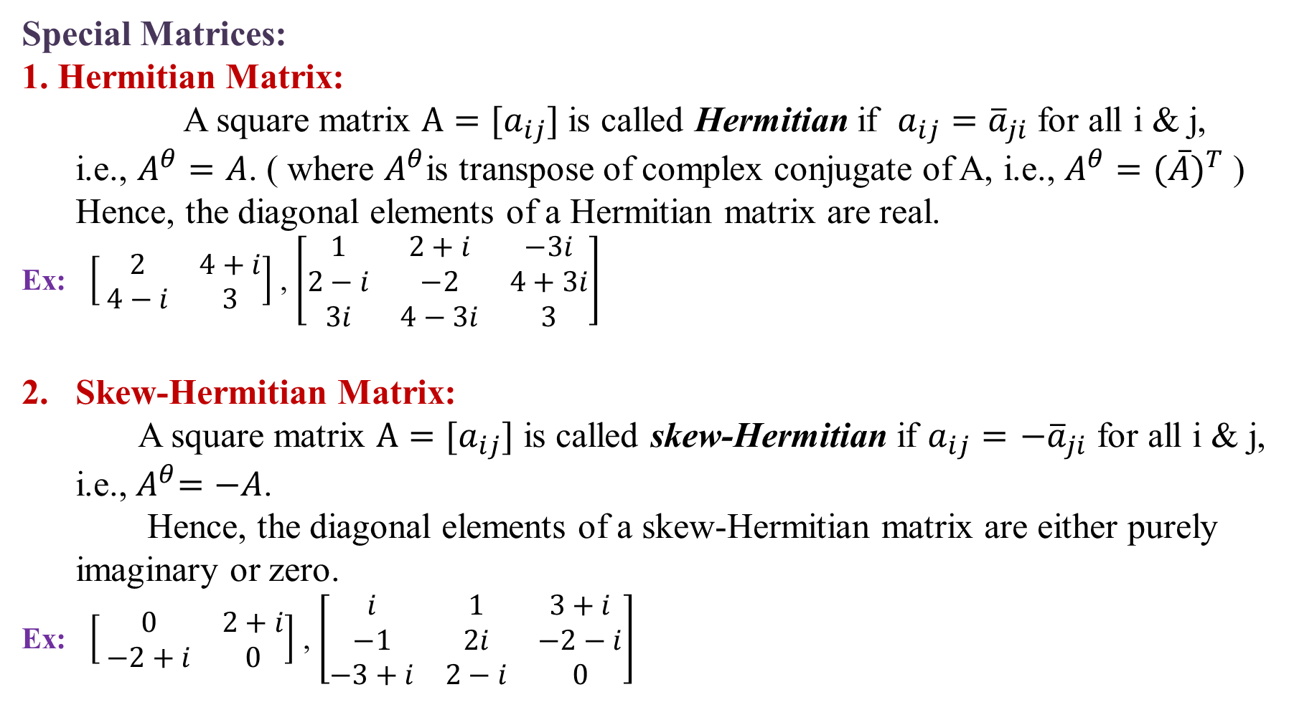
Special Matrices:
1. Hermitian Matrix:
A square matrix $A=[a_{ij}]$ is called Hermitian if $a_{ij}={\overline{a}}_{ji}$ for all i & j,
i.e., $A^{θ}=A$.( where $A^{θ}$is transpose of complex conjugate of A, i.e., $A^{θ}={(\overline{A})}^{T}$)
Hence, the diagonal elements of a Hermitian matrix are real.
Ex:$\left[ \begin{matrix}2 & 4+i \\ 4−i & 3\end{matrix}\right]$ , $\left[\begin{matrix}1 & 2+i & −3i \\ 2−i & −2 & 4+3i \\ 3i & 4−3i & 3\end{matrix}\right]$
Skew-Hermitian Matrix:
A square matrix $A=[a_{ij}]$ is called skew-Hermitian if $a_{ij}=$$−{\overline{a}}_{ji}$ for all i & j,
i.e.,${ A}^{θ}=−A$.
Hence, the diagonal elements of a skew-Hermitian matrix are either purely
imaginary or zero.
Ex:$\left[ \begin{matrix}0 & 2+i \\ −2+i & 0\end{matrix}\right]$ , $\left[\begin{matrix}i & 1 & 3+i \\ −1 & 2i & −2−i \\ −3+i & 2−i & 0\end{matrix}\right]$

Slide 4
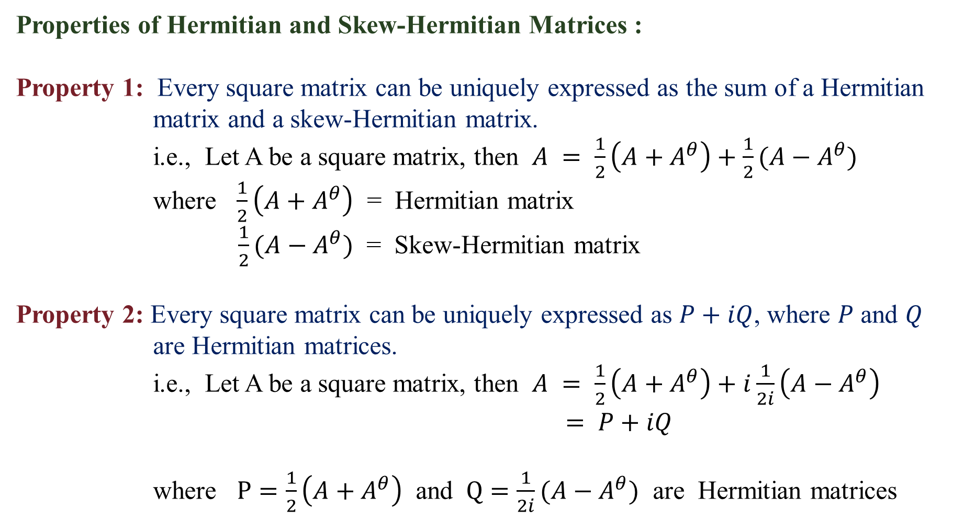
Properties of Hermitian and Skew-Hermitian Matrices :
Property 1: Every square matrix can be uniquely expressed as the sum of a Hermitian
matrix and a skew-Hermitian matrix.
i.e., Let A be a square matrix, then $A = \frac{1}{2}\left(A+A^{θ}\right)+\frac{1}{2}(A−A^{θ})$
where $\frac{1}{2}\left(A+A^{θ}\right)$ = Hermitian matrix
$\frac{1}{2}(A−A^{θ})$ = Skew-Hermitian matrix
Property 2: Every square matrix can be uniquely expressed as $P+iQ$, where $P$ and $Q$
are Hermitian matrices.
i.e., Let A be a square matrix, then $A = \frac{1}{2}\left(A+A^{θ}\right)+i\frac{1}{2i}\left(A−A^{θ}\right)$
$= P+iQ$
where $P=\frac{1}{2}\left(A+A^{θ}\right)$ and $Q=\frac{1}{2i}(A−A^{θ})$ are Hermitian matrices

Slide 5
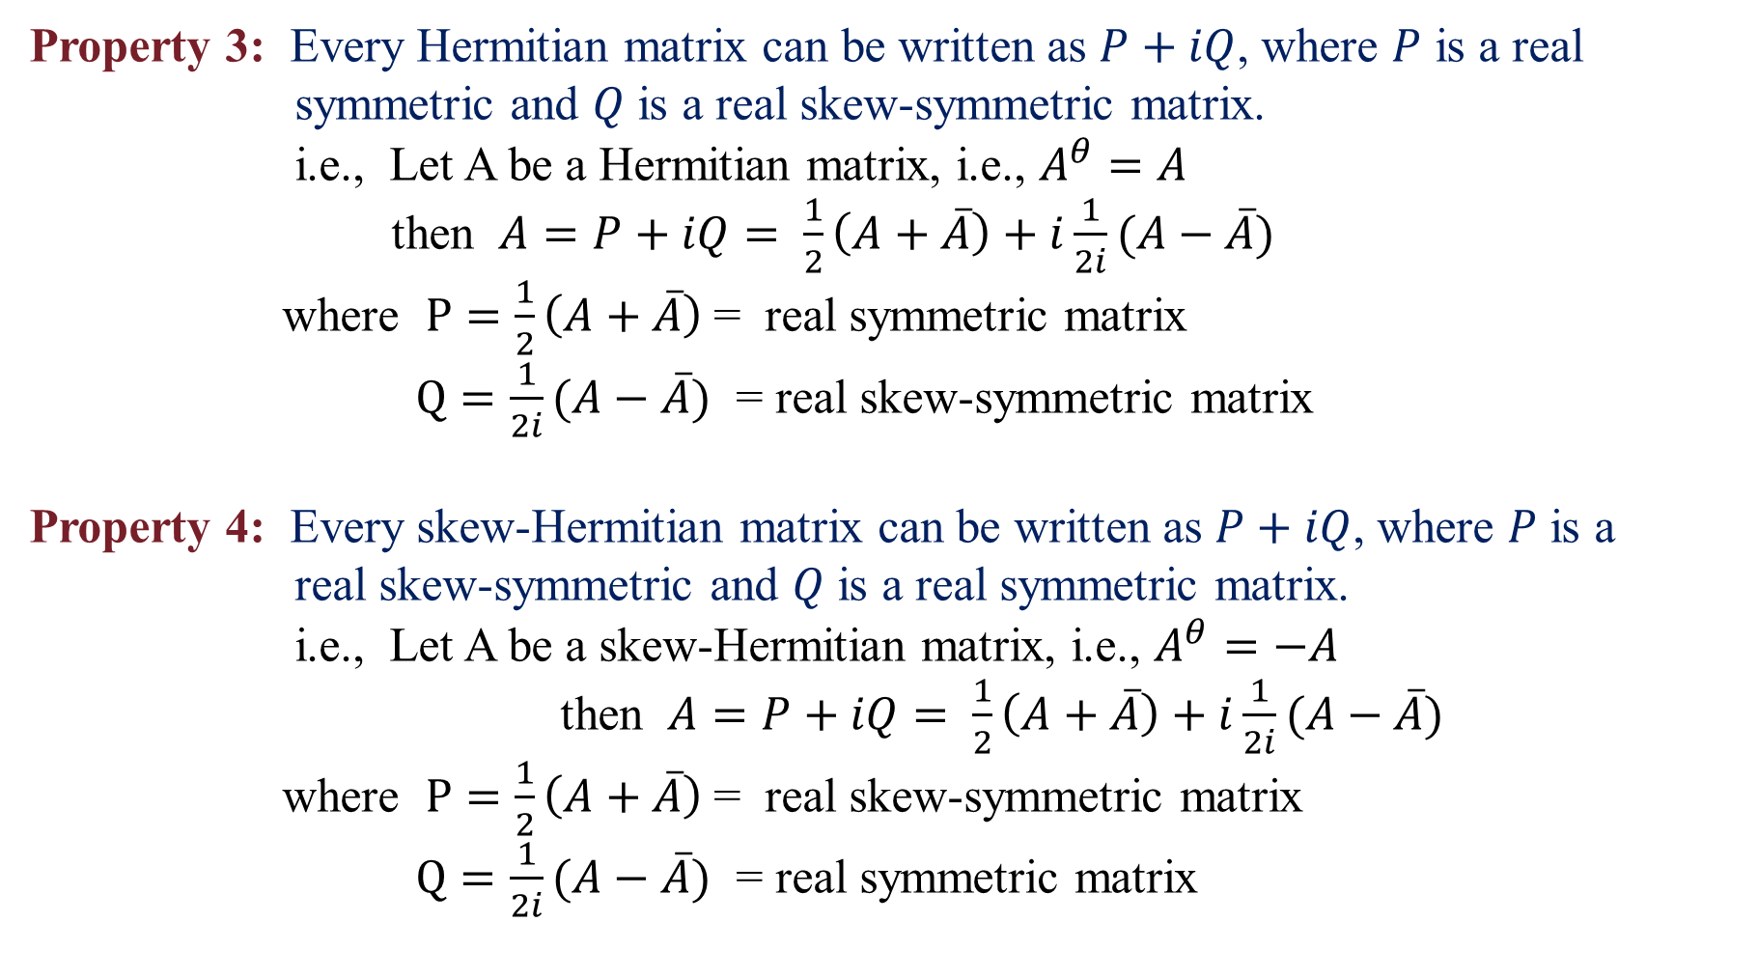
Property 3: Every Hermitian matrix can be written as $P+iQ$, where $P$ is a real
symmetric and $Q$ is a real skew-symmetric matrix.
i.e., Let A be a Hermitian matrix, i.e., $A^{θ}=A$
then $A=P+iQ= \frac{1}{2}\left(A+\overline{A}\right)+i\frac{1}{2i}(A−\overline{A})$
where $P=\frac{1}{2}\left(A+\overline{A}\right)$= real symmetric matrix
$Q=\frac{1}{2i}(A−\overline{A})$ = real skew-symmetric matrix
Property 4: Every skew-Hermitian matrix can be written as $P+iQ$, where $P$ is a
real skew-symmetric and $Q$ is a real symmetric matrix.
i.e., Let A be a skew-Hermitian matrix, i.e., $A^{θ}=−A$
then $A=P+iQ= \frac{1}{2}\left(A+\overline{A}\right)+i\frac{1}{2i}(A−\overline{A})$
where $P=\frac{1}{2}\left(A+\overline{A}\right)$= real skew-symmetric matrix
$Q=\frac{1}{2i}(A−\overline{A})$ = real symmetric matrix

Slide 6
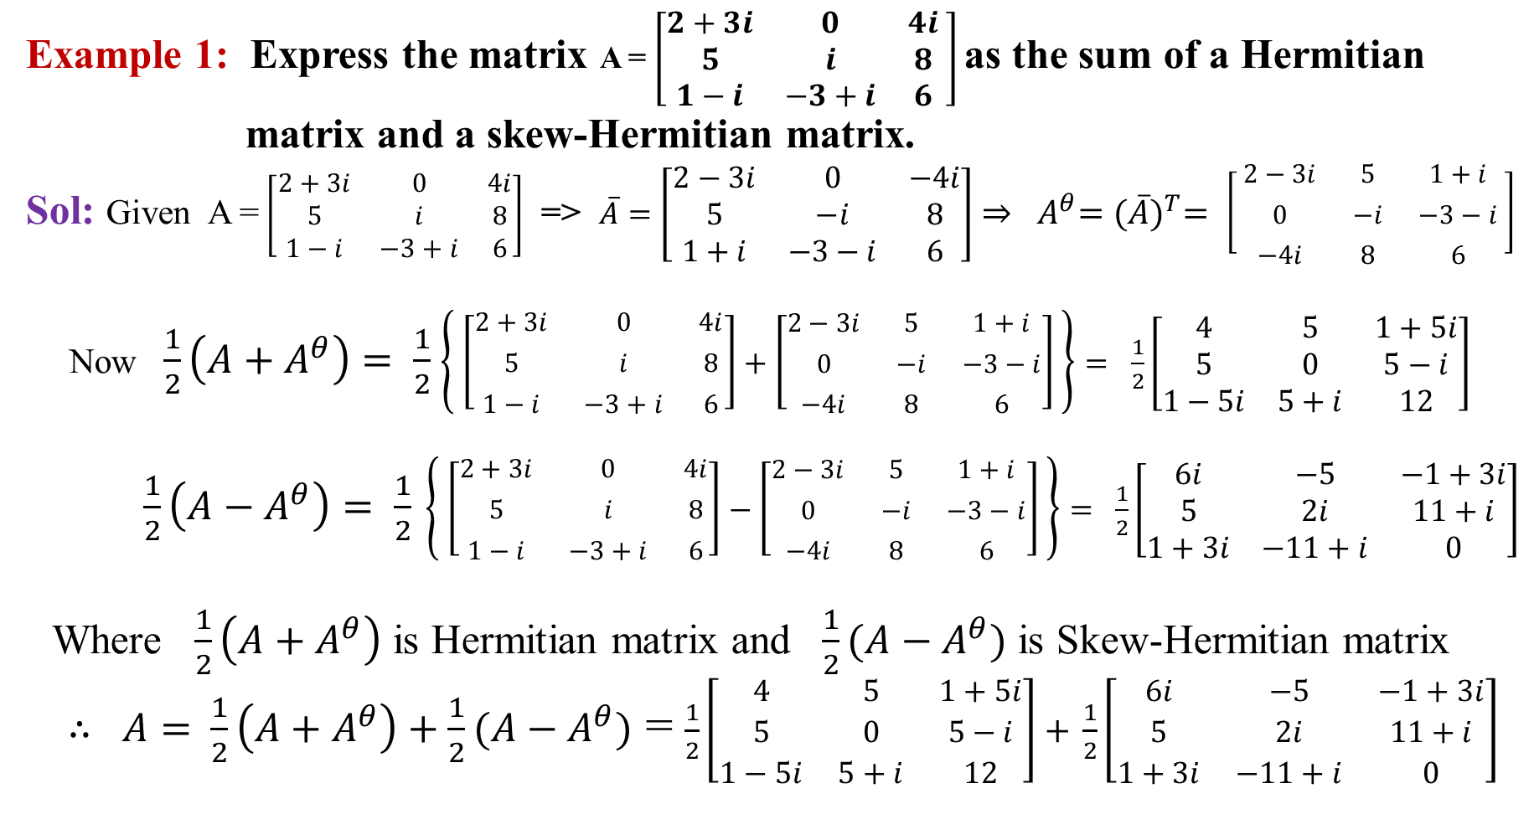
Example 1: Express the matrix A = $\left[\begin{matrix}2+3i & 0 & 4i \\ 5 & i & 8 \\ 1−i & −3+i & 6\end{matrix} \right]$as the sum of a Hermitian
matrix and a skew-Hermitian matrix.
Sol:Given A =$\left[\begin{matrix}2+3i & 0 & 4i \\ 5 & i & 8 \\ 1−i & −3+i & 6\end{matrix}\right]$=>$\overline{A}=\left[\begin{matrix}2−3i & 0 & −4i \\ 5 & −i & 8 \\ 1+i & −3−i & 6\end{matrix}\right]$${⇒ A}^{θ}={(\overline{A})}^{T}= \left[ \begin{matrix}2−3i & 5 & 1+i \\ 0 & −i & −3−i \\ −4i & 8 & 6\end{matrix} \right]$
Now $\frac{1}{2}\left(A+A^{θ}\right)$$= \frac{1}{2}$$\left\{ \left[\begin{matrix}2+3i & 0 & 4i \\ 5 & i & 8 \\ 1−i & −3+i & 6\end{matrix}\right]+\left[\begin{matrix}2−3i & 5 & 1+i \\ 0 & −i & −3−i \\ −4i & 8 & 6\end{matrix}\right] \right\}$$= \frac{1}{2}\left[\begin{matrix}4 & 5 & 1+5i \\ 5 & 0 & 5−i \\ 1−5i & 5+i & 12\end{matrix}\right]$
$\frac{1}{2}\left(A−A^{θ}\right)= \frac{1}{2}$$\left\{ \left[\begin{matrix}2+3i & 0 & 4i \\ 5 & i & 8 \\ 1−i & −3+i & 6\end{matrix}\right]−\left[\begin{matrix}2−3i & 5 & 1+i \\ 0 & −i & −3−i \\ −4i & 8 & 6\end{matrix}\right] \right\}$$= \frac{1}{2}\left[\begin{matrix}6i & −5 & −1+3i \\ 5 & 2i & 11+i \\ 1+3i & −11+i & 0\end{matrix}\right]$
Where$\frac{1}{2}\left(A+A^{θ}\right)$ is Hermitian matrix and $\frac{1}{2}(A−A^{θ})$ is Skew-Hermitian matrix
$∴ A=$$\frac{1}{2}\left(A+A^{θ}\right)+\frac{1}{2}(A−A^{θ})$ = $\frac{1}{2}\left[\begin{matrix}4 & 5 & 1+5i \\ 5 & 0 & 5−i \\ 1−5i & 5+i & 12\end{matrix}\right]+$$\frac{1}{2}\left[\begin{matrix}6i & −5 & −1+3i \\ 5 & 2i & 11+i \\ 1+3i & −11+i & 0\end{matrix}\right]$

Slide 7
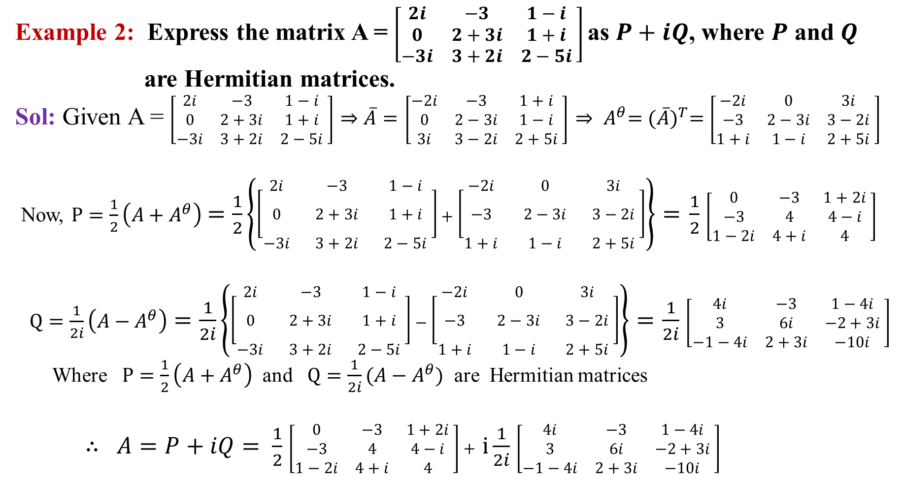
Example 2: Express the matrix A = $\left[\begin{matrix}2i & −3 & 1−i \\ 0 & 2+3i & 1+i \\ −3i & 3+2i & 2−5i\end{matrix} \right]$as $P+iQ$, where $P$ and $Q$
are Hermitian matrices.
Sol:Given A = $\left[\begin{matrix}2i & −3 & 1−i \\ 0 & 2+3i & 1+i \\ −3i & 3+2i & 2−5i\end{matrix} \right]$$⇒\overline{A}=$$\left[\begin{matrix}−2i & −3 & 1+i \\ 0 & 2−3i & 1−i \\ 3i & 3−2i & 2+5i\end{matrix} \right]$${⇒ A}^{θ}={(\overline{A})}^{T}=$$\left[\begin{matrix}−2i & 0 & 3i \\ −3 & 2−3i & 3−2i \\ 1+i & 1−i & 2+5i\end{matrix} \right]$
Now,$P=\frac{1}{2}\left(A+A^{θ}\right)$$=\frac{1}{2}\left\{\left[\begin{matrix}2i & −3 & 1−i \\ 0 & 2+3i & 1+i \\ −3i & 3+2i & 2−5i\end{matrix} \right]+\left[\begin{matrix}−2i & 0 & 3i \\ −3 & 2−3i & 3−2i \\ 1+i & 1−i & 2+5i\end{matrix} \right]\right\}=$$\frac{1}{2}$$\left[\begin{matrix}0 & −3 & 1+2i \\ −3 & 4 & 4−i \\ 1−2i & 4+i & 4\end{matrix} \right]$
$Q=\frac{1}{2i}\left(A−A^{θ}\right)$$=\frac{1}{2i}\left\{\left[\begin{matrix}2i & −3 & 1−i \\ 0 & 2+3i & 1+i \\ −3i & 3+2i & 2−5i\end{matrix} \right]−\left[\begin{matrix}−2i & 0 & 3i \\ −3 & 2−3i & 3−2i \\ 1+i & 1−i & 2+5i\end{matrix} \right]\right\}=$$\frac{1}{2i}$$\left[\begin{matrix}4i & −3 & 1−4i \\ 3 & 6i & −2+3i \\ −1−4i & 2+3i & −10i\end{matrix} \right]$
Where$P=\frac{1}{2}\left(A+A^{θ}\right)$and $Q=\frac{1}{2i}(A−A^{θ})$ are Hermitian matrices
$∴ A=P+iQ= \frac{1}{2}$$\left[\begin{matrix}0 & −3 & 1+2i \\ −3 & 4 & 4−i \\ 1−2i & 4+i & 4\end{matrix} \right]+$$i\frac{1}{2i}$$\left[\begin{matrix}4i & −3 & 1−4i \\ 3 & 6i & −2+3i \\ −1−4i & 2+3i & −10i\end{matrix} \right]$

Slide 8
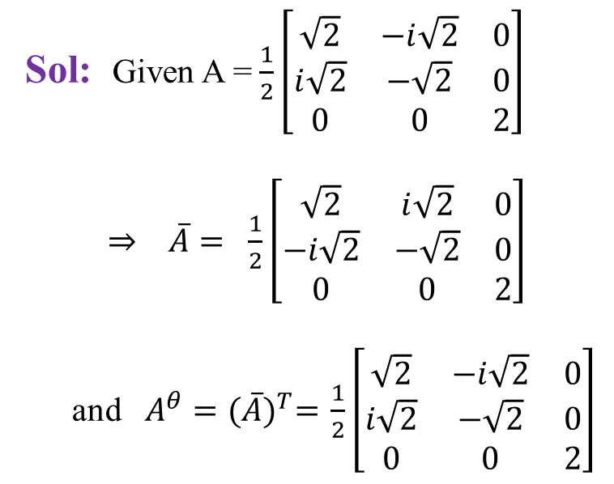
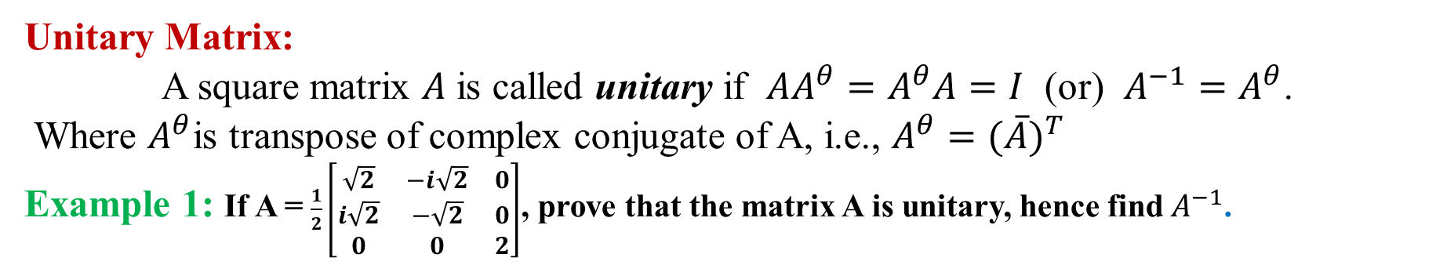
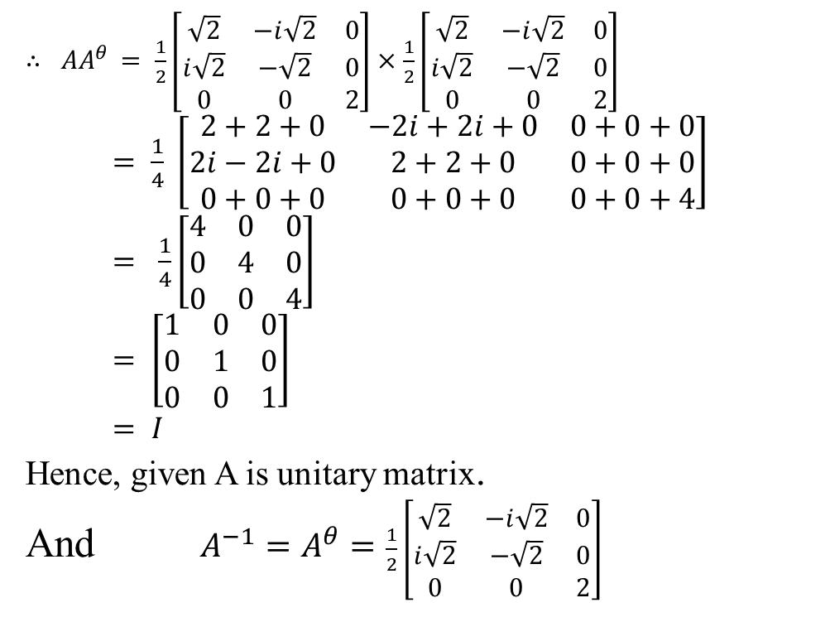
Unitary Matrix:
A square matrix $A$ is called unitary if $AA^{θ}=A^{θ}A=I$ (or) $A^{−1}=A^{θ}$.
Where $A^{θ}$is transpose of complex conjugate of A, i.e., $A^{θ}={(\overline{A})}^{T}$
Example 1:If A = $\frac{1}{2}\left[\begin{matrix}\sqrt{2} & −i\sqrt{2} & 0 \\ i\sqrt{2} & −\sqrt{2} & 0 \\ 0 & 0 & 2\end{matrix}\right]$, prove that the matrix A is unitary, hence find${ A}^{−1}$.
$∴ AA^{θ}$$= \frac{1}{2}\left[\begin{matrix}\sqrt{2} & −i\sqrt{2} & 0 \\ i\sqrt{2} & −\sqrt{2} & 0 \\ 0 & 0 & 2\end{matrix}\right]×\frac{1}{2}\left[\begin{matrix}\sqrt{2} & −i\sqrt{2} & 0 \\ i\sqrt{2} & −\sqrt{2} & 0 \\ 0 & 0 & 2\end{matrix}\right]$
$= \frac{1}{4} \left[\begin{matrix}2+2+0 & −2i+2i+0 & 0+0+0 \\ 2i−2i+0 & 2+2+0 & 0+0+0 \\ 0+0+0 & 0+0+0 & 0+0+4\end{matrix}\right]$
$= \frac{1}{4}\left[\begin{matrix}4 & 0 & 0 \\ 0 & 4 & 0 \\ 0 & 0 & 4\end{matrix}\right]$
$= \left[\begin{matrix}1 & 0 & 0 \\ 0 & 1 & 0 \\ 0 & 0 & 1\end{matrix}\right]$
$= I$
Hence, given A is unitary matrix.
And $A^{−1}=A^{θ}=$$\frac{1}{2}\left[\begin{matrix}\sqrt{2} & −i\sqrt{2} & 0 \\ i\sqrt{2} & −\sqrt{2} & 0 \\ 0 & 0 & 2\end{matrix}\right]$
Sol:Given A = $\frac{1}{2}\left[\begin{matrix}\sqrt{2} & −i\sqrt{2} & 0 \\ i\sqrt{2} & −\sqrt{2} & 0 \\ 0 & 0 & 2\end{matrix}\right]$
$⇒ \overline{A}=$$\frac{1}{2}\left[\begin{matrix}\sqrt{2} & i\sqrt{2} & 0 \\ −i\sqrt{2} & −\sqrt{2} & 0 \\ 0 & 0 & 2\end{matrix}\right]$
and$A^{θ}={(\overline{A})}^{T}=$$\frac{1}{2}\left[\begin{matrix}\sqrt{2} & −i\sqrt{2} & 0 \\ i\sqrt{2} & −\sqrt{2} & 0 \\ 0 & 0 & 2\end{matrix}\right]$

Slide 9
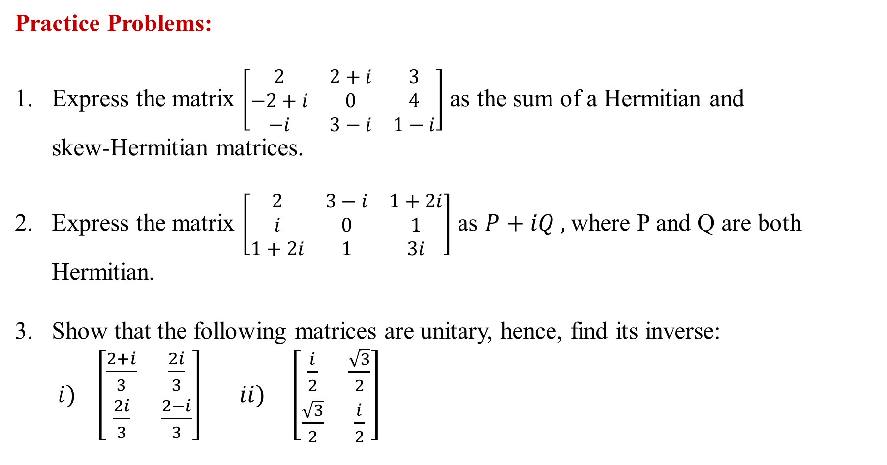
Practice Problems:
Express the matrix $\left[\begin{matrix}2 & 2+i & 3 \\ −2+i & 0 & 4 \\ −i & 3−i & 1−i\end{matrix}\right]$ as the sum of a Hermitian and
skew-Hermitian matrices.
2. Express the matrix $\left[\begin{matrix}2 & 3−i & 1+2i \\ i & 0 & 1 \\ 1+2i & 1 & 3i\end{matrix}\right]$ as $P+iQ ,$where P and Q are both
Hermitian.
3. Show that the following matrices are unitary, hence, find its inverse:
$i) \left[\begin{matrix}\frac{2+i}{3} & \frac{2i}{3} \\ \frac{2i}{3} & \frac{2−i}{3}\end{matrix}\right]$$ii) \left[\begin{matrix}\frac{i}{2} & \frac{\sqrt{3}}{2} \\ \frac{\sqrt{3}}{2} & \frac{i}{2}\end{matrix}\right]$

Slide 10
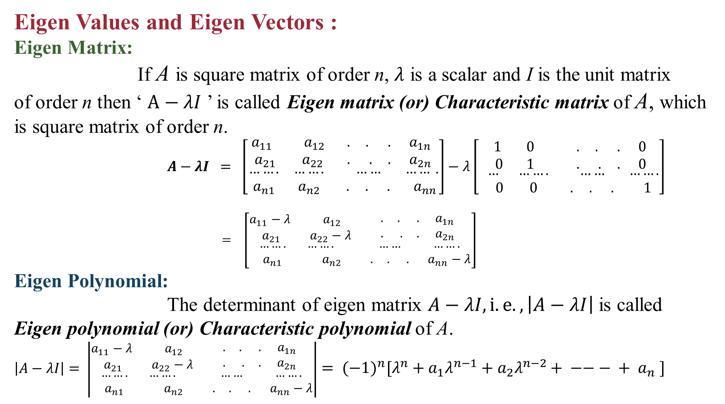
Eigen Values and Eigen Vectors :
Eigen Matrix:
If A is square matrix of order n, $λ$ is a scalar and I is the unit matrix
of order n then ‘ $A−λI$ ’ is called Eigen matrix (or) Characteristic matrix of A, which is square matrix of order n.
$A−λI = \left[\begin{matrix}\begin{matrix}a_{11} & a_{12} \\ a_{21} & a_{22}\end{matrix} & \begin{matrix}. . . & a_{1n} \\ . . . & a_{2n}\end{matrix} \\ \begin{matrix}……. & ……. \\ a_{n1} & a_{n2}\end{matrix} & \begin{matrix} …… & …… . \\ . . . & a_{nn}\end{matrix}\end{matrix}\right]−λ\left[\begin{matrix}\begin{matrix}1 & 0 \\ 0 & 1\end{matrix} & \begin{matrix}. . . & 0 \\ . . . & 0\end{matrix} \\ \begin{matrix} … & ……. \\ 0 & 0\end{matrix} & \begin{matrix} …… & ……. \\ . . . & 1\end{matrix}\end{matrix}\right]$
$= \left[\begin{matrix}\begin{matrix}a_{11}−λ & a_{12} \\ a_{21} & a_{22}−λ\end{matrix} & \begin{matrix}. . . & a_{1n} \\ . . . & a_{2n}\end{matrix} \\ \begin{matrix}……. & ……. \\ a_{n1} & a_{n2}\end{matrix} & \begin{matrix} …… & ……. \\ . . . & a_{nn}−λ\end{matrix}\end{matrix}\right]$
Eigen Polynomial:
The determinant of eigen matrix $A−λI, i.e., \left|A−λI\right|$ is called
Eigen polynomial (or) Characteristic polynomial ofA.
$\left|A−λI\right|=$$\left|\begin{matrix}\begin{matrix}a_{11}−λ & a_{12} \\ a_{21} & a_{22}−λ\end{matrix} & \begin{matrix}. . . & a_{1n} \\ . . . & a_{2n}\end{matrix} \\ \begin{matrix}……. & ……. \\ a_{n1} & a_{n2}\end{matrix} & \begin{matrix} …… & ……. \\ . . . & a_{nn}−λ\end{matrix}\end{matrix}\right|$$= {(−1)}^{n}[λ^{n}+a_{1}λ^{n−1}+a_{2}λ^{n−2}+ −−− + a_{n} ]$

Slide 11
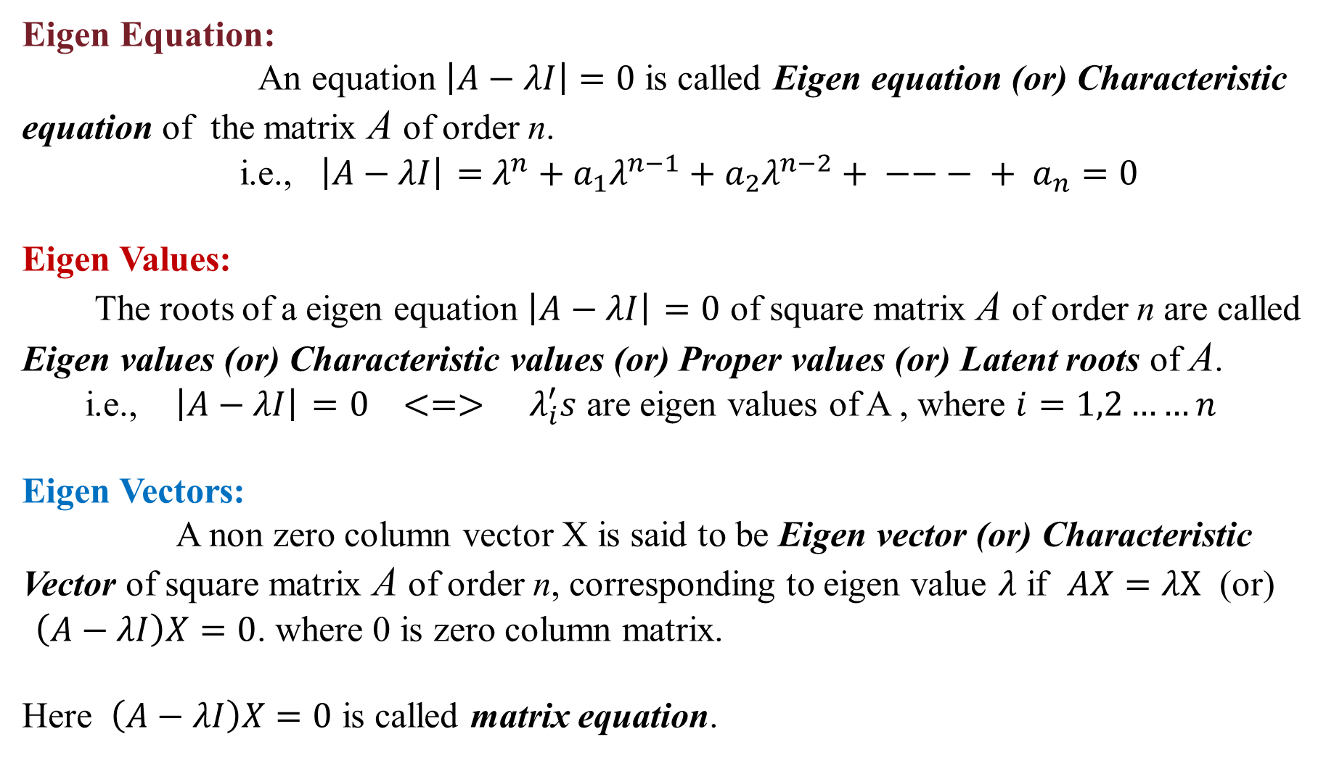
Eigen Equation:
An equation $\left|A−λI\right|=0$ is called Eigen equation (or) Characteristic equation of the matrix A of ordern.
i.e., $\left|A−λI\right|$$=$$λ^{n}+a_{1}λ^{n−1}+a_{2}λ^{n−2}+ −−− + a_{n}=0$
Eigen Values:
The roots of a eigen equation $\left|A−λI\right|$$=0$ of square matrix A of order n are called Eigen values (or) Characteristic values (or) Proper values (or) Latent roots of A.
i.e., $\left|A−λI\right|$$=0$$<=>$$λ_{i}^{′}s$ are eigen values of A , where $i=1,2……n$
Eigen Vectors:
A non zero column vector X is said to be Eigen vector (or) Characteristic
Vector of square matrix A of order n, corresponding to eigen value $λ$ if $AX=λX$ (or)
$\left(A−λI\right)X=0$. where 0 is zero column matrix.
Here $\left(A−λI\right)X=0$ is called matrix equation.

Slide 12
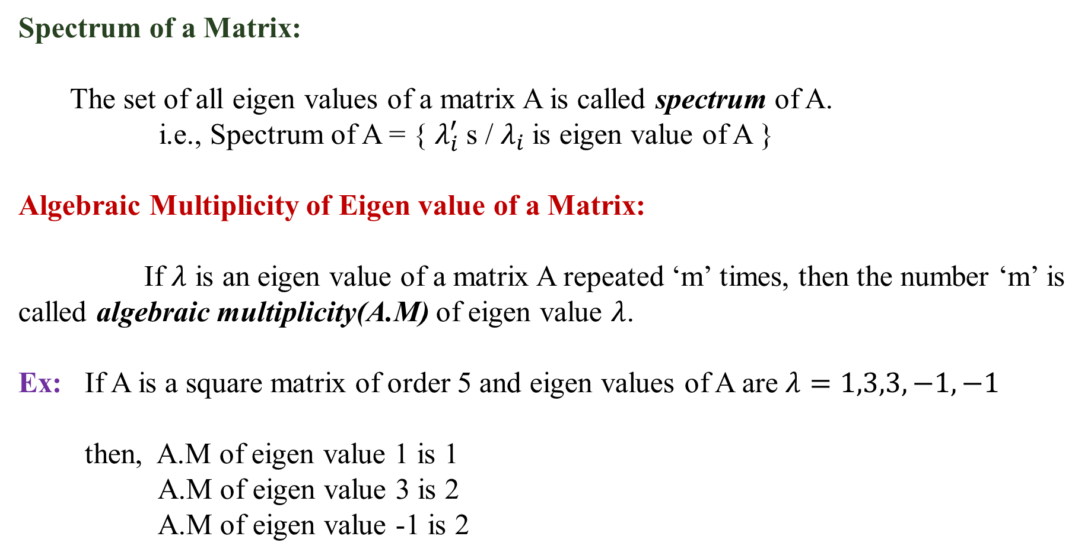
Spectrum of a Matrix:
The set of all eigen values of a matrix A is called spectrum of A.
i.e., Spectrum of A = { $λ_{i}^{′}$s / $λ_{i}$is eigen value of A }
Algebraic Multiplicity of Eigen value of a Matrix:
If $λ$ is an eigen value of a matrix A repeated ‘m’ times, then the number ‘m’ is called algebraic multiplicity(A.M) of eigen value $λ$.
Ex: If A is a square matrix of order 5 and eigen values of A are $λ=1,3,3,−1,−1$
then, A.M of eigen value 1 is 1
A.M of eigen value 3 is 2
A.M of eigen value -1 is 2

Slide 13
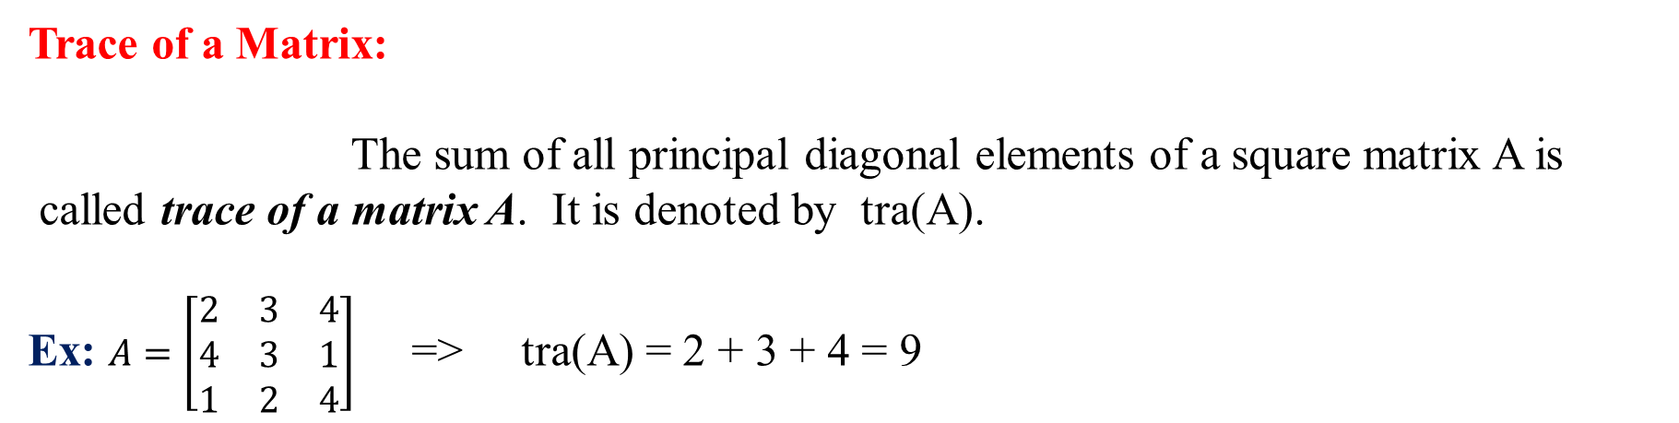
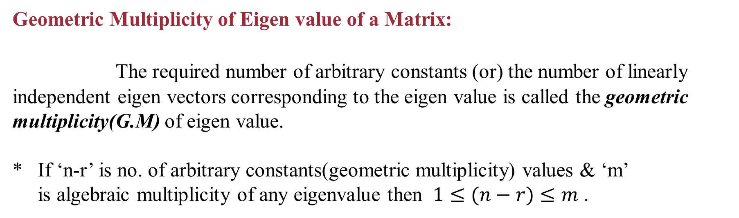
Geometric Multiplicity of Eigen value of a Matrix:
The required number of arbitrary constants (or) the number of linearly independent eigen vectors corresponding to the eigen value is called the geometric multiplicity(G.M) of eigen value.
* If ‘n-r’ is no. of arbitrary constants(geometric multiplicity) values & ‘m’
is algebraic multiplicity of any eigenvalue then $1≤(n−r)≤m$ .
Trace of a Matrix:
The sum of all principal diagonal elements of a square matrix A is
called trace of a matrix A. It is denoted by tra(A).
Ex:$A=$$\left[\begin{matrix}2 & 3 & 4 \\ 4 & 3 & 1 \\ 1 & 2 & 4\end{matrix}\right]$ =>tra(A) = 2 + 3 + 4 = 9

Slide 14
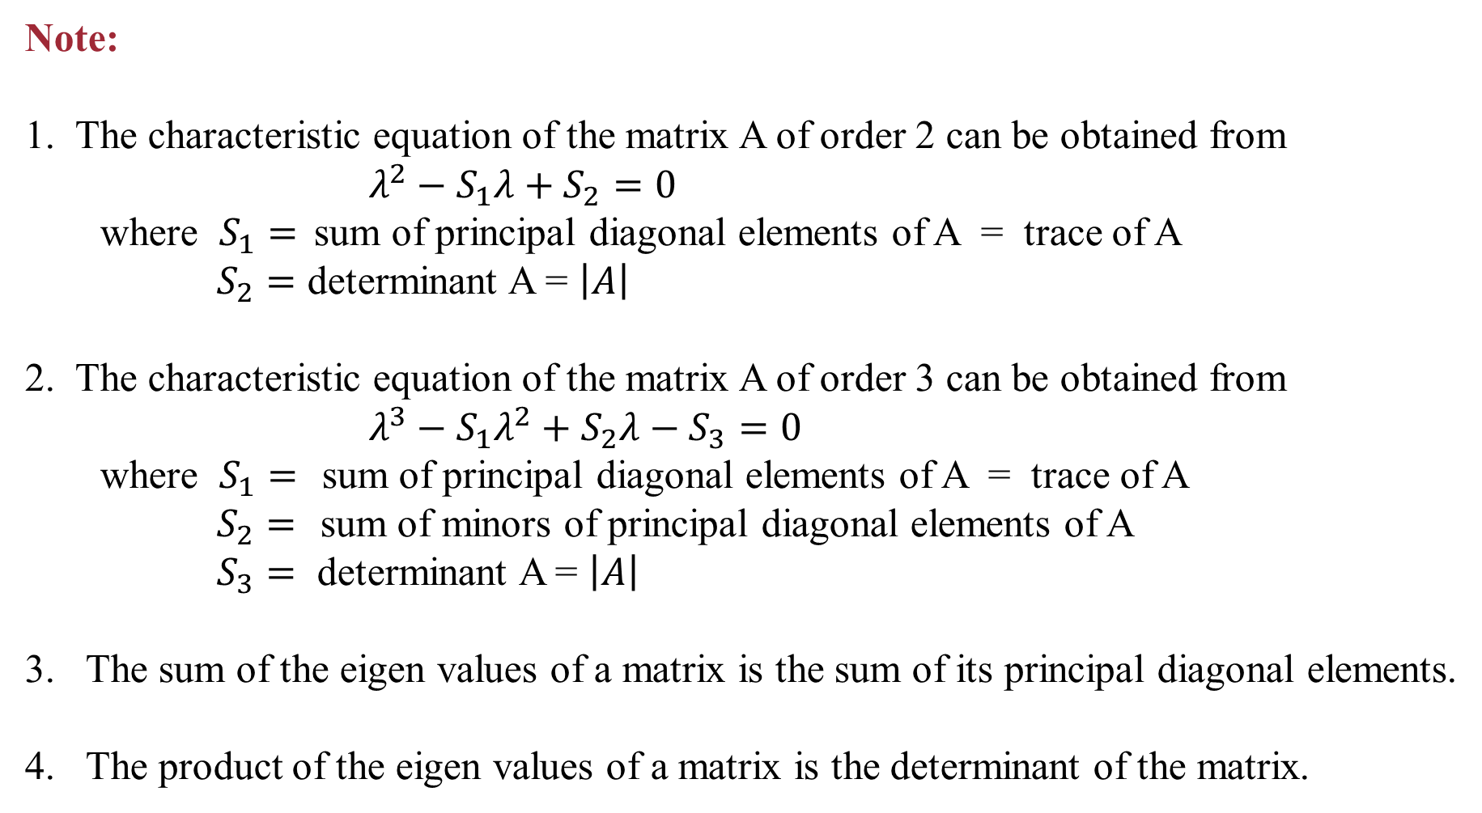
Note:
1. The characteristic equation of the matrix A of order 2 can be obtained from
$λ^{2}−S_{1}λ+S_{2}=0$
where $S_{1}=$sum of principal diagonal elements of A = trace of A
$S_{2}=$ determinant A = $\left|A\right|$
2. The characteristic equation of the matrix A of order 3 can be obtained from
$λ^{3}−S_{1}λ^{2}+S_{2}λ−S_{3}=0$
where $S_{1}=$sum of principal diagonal elements of A = trace of A
$S_{2}=$sum of minors of principal diagonal elements of A
$S_{3}=$ determinant A = $\left|A\right|$
The sum of the eigen values of a matrix is the sum of its principal diagonal elements.
The product of the eigen values of a matrix is the determinant of the matrix.

Slide 15
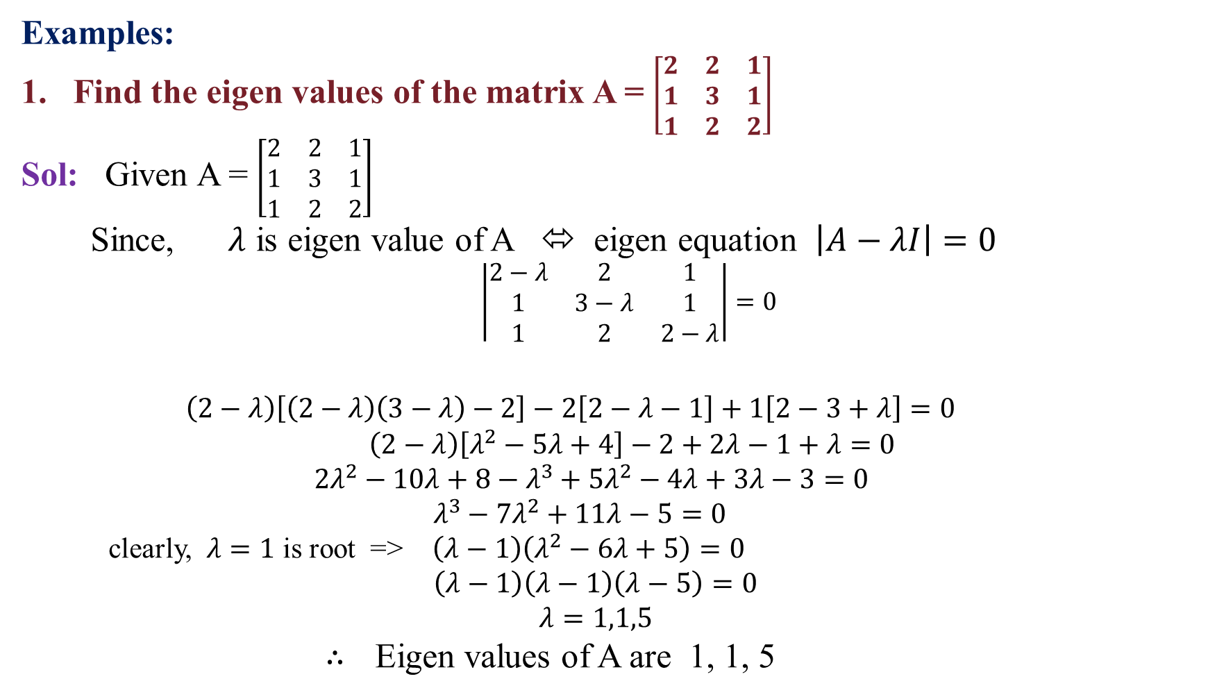
Examples:
Find the eigen values of the matrix A = $\left[\begin{matrix}2 & 2 & 1 \\ 1 & 3 & 1 \\ 1 & 2 & 2\end{matrix}\right]$
Sol: Given A = $\left[\begin{matrix}2 & 2 & 1 \\ 1 & 3 & 1 \\ 1 & 2 & 2\end{matrix}\right]$
Since, $λ$ is eigen value of A ⬄ eigen equation $\left|A−λI\right|=0$
$\left|\begin{matrix}2−λ & 2 & 1 \\ 1 & 3−λ & 1 \\ 1 & 2 & 2−λ\end{matrix}\right|=0$
$\left(2−λ\right)\left[\left(2−λ\right)\left(3−λ\right)−2\right]−2\left[2−λ−1\right]+1\left[2−3+λ\right]=0$
$\left(2−λ\right)\left[λ^{2}−5λ+4\right]−2+2λ−1+λ=0$
$2λ^{2}−10λ+8−λ^{3}+5λ^{2}−4λ+3λ−3=0$
$λ^{3}−7λ^{2}+11λ−5=0$
clearly, $λ=1$ is root =>$\left(λ−1\right)\left(λ^{2}−6λ+5\right)=0$
$\left(λ−1\right)\left(λ−1\right)\left(λ−5\right)=0$
$λ=1,1,5$
$∴$Eigen values of A are 1, 1, 5

Slide 16
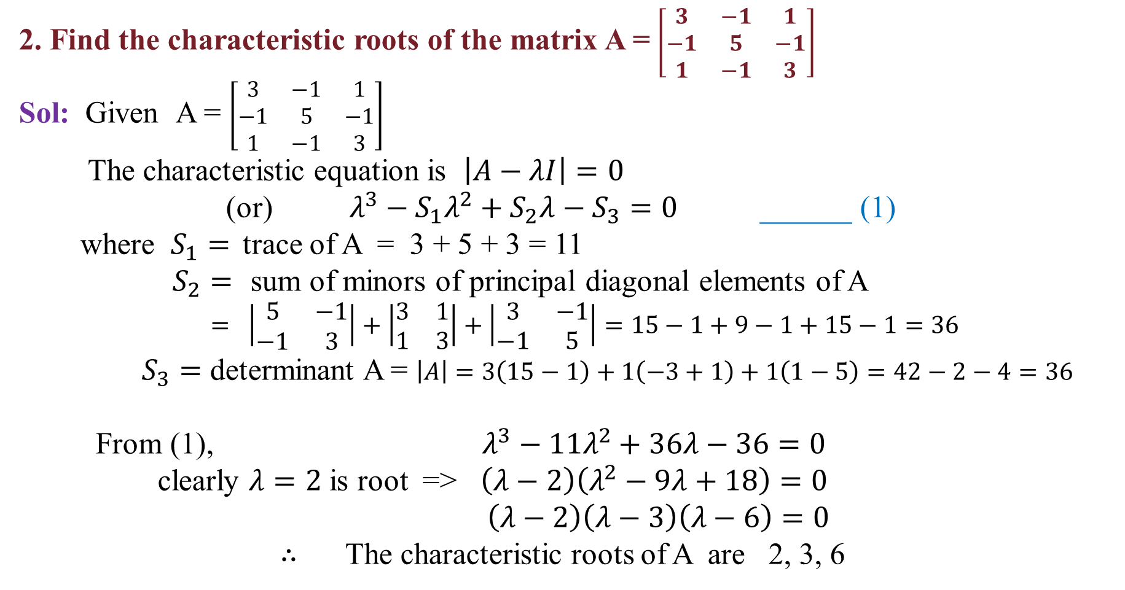
2. Find the characteristic rootsof the matrix A = $\left[\begin{matrix}3 & −1 & 1 \\ −1 & 5 & −1 \\ 1 & −1 & 3\end{matrix}\right]$
Sol: Given A = $\left[\begin{matrix}3 & −1 & 1 \\ −1 & 5 & −1 \\ 1 & −1 & 3\end{matrix}\right]$
The characteristic equation is $\left|A−λI\right|=0$
(or) $λ^{3}−S_{1}λ^{2}+S_{2}λ−S_{3}=0$______ (1)
where $S_{1}=$trace of A = 3 + 5 + 3 = 11
$S_{2}=$sum of minors of principal diagonal elements of A
$= \left|\begin{matrix}5 & −1 \\ −1 & 3\end{matrix}\right|+\left|\begin{matrix}3 & 1 \\ 1 & 3\end{matrix}\right|+\left|\begin{matrix}3 & −1 \\ −1 & 5\end{matrix}\right|=15−1+9−1+15−1=36$
$S_{3}=$ determinant A = $\left|A\right|=3\left(15−1\right)+1\left(−3+1\right)+1\left(1−5\right)=42−2−4=36$
From (1), $λ^{3}−11λ^{2}+36λ−36=0$
clearly $λ=2$ is root =>$\left(λ−2\right)\left(λ^{2}−9λ+18\right)=0$
$\left(λ−2\right)\left(λ−3\right)\left(λ−6\right)=0$
$∴$ The characteristic roots of A are 2, 3, 6

Slide 17
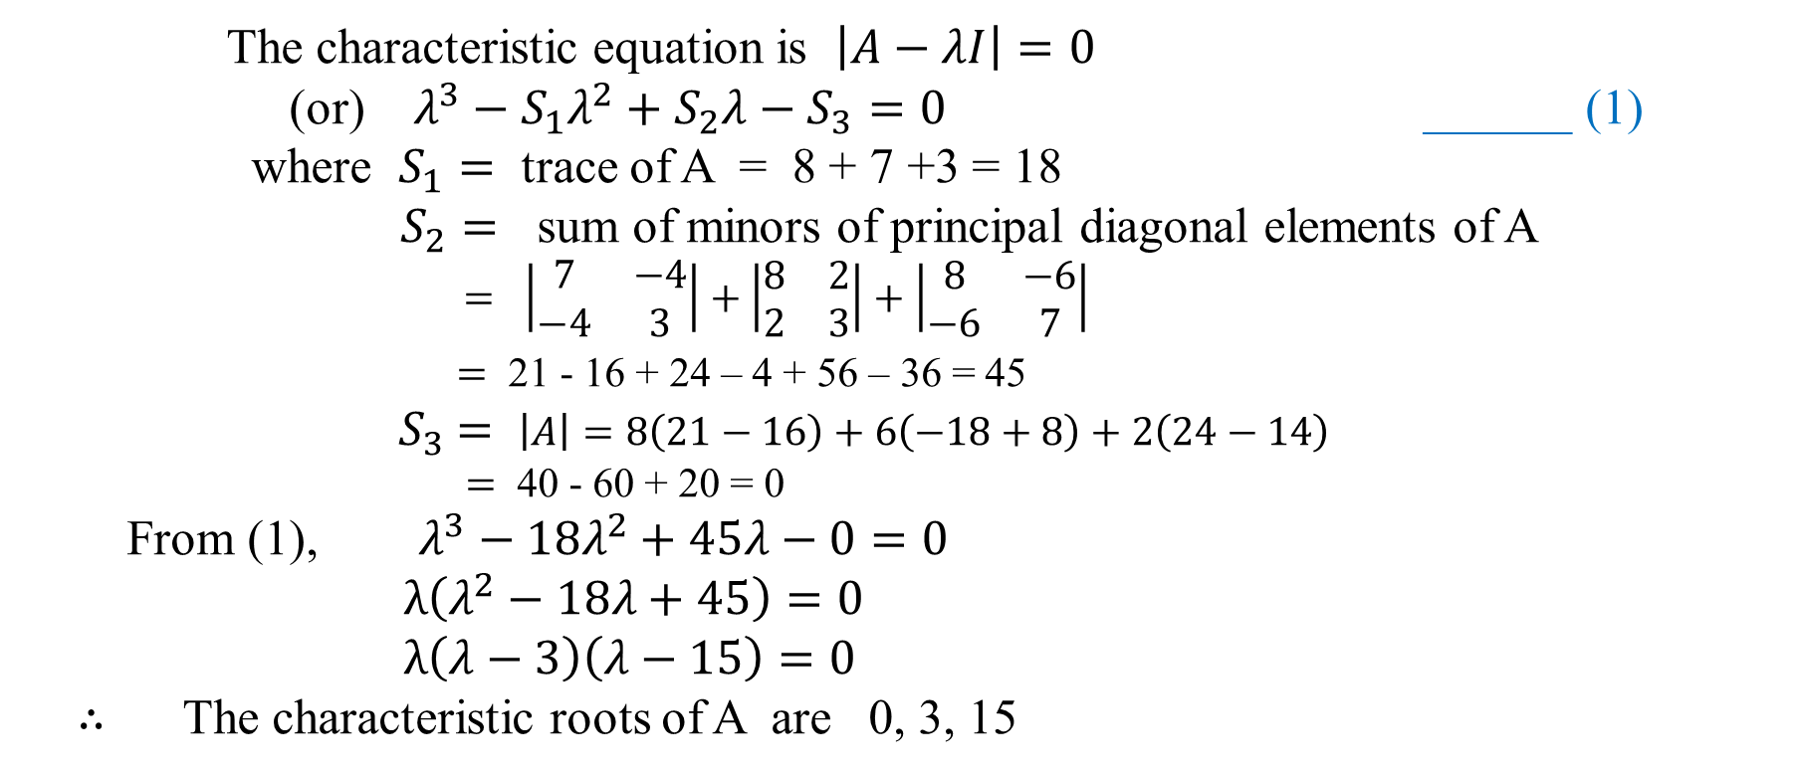

3. Find the eigen values and eigen vectors of the matrix A = $\left[\begin{matrix}8 & −6 & 2 \\ −6 & 7 & −4 \\ 2 & −4 & 3\end{matrix}\right]$
Sol: Given A = $\left[\begin{matrix}8 & −6 & 2 \\ −6 & 7 & −4 \\ 2 & −4 & 3\end{matrix}\right]$
The characteristic equation is $\left|A−λI\right|=0$
(or) $λ^{3}−S_{1}λ^{2}+S_{2}λ−S_{3}=0$______ (1)
where $S_{1}=$ trace of A = 8 + 7 +3 = 18
$S_{2}=$ sum of minors of principal diagonal elements of A
$= \left|\begin{matrix}7 & −4 \\ −4 & 3\end{matrix}\right|+\left|\begin{matrix}8 & 2 \\ 2 & 3\end{matrix}\right|+\left|\begin{matrix}8 & −6 \\ −6 & 7\end{matrix}\right|$
$=$ 21 - 16 + 24 – 4 + 56 – 36 = 45
${ S}_{3} =$$\left|A\right|=8\left(21−16\right)+6\left(−18+8\right)+2\left(24−14\right)$
$=$ 40 - 60 + 20 = 0
From (1), $λ^{3}−18λ^{2}+45λ−0=0$
$λ\left(λ^{2}−18λ+45\right)=0$
$λ\left(λ−3\right)\left(λ−15\right)=0$
$∴$ The characteristic roots of A are 0, 3, 15

Slide 18
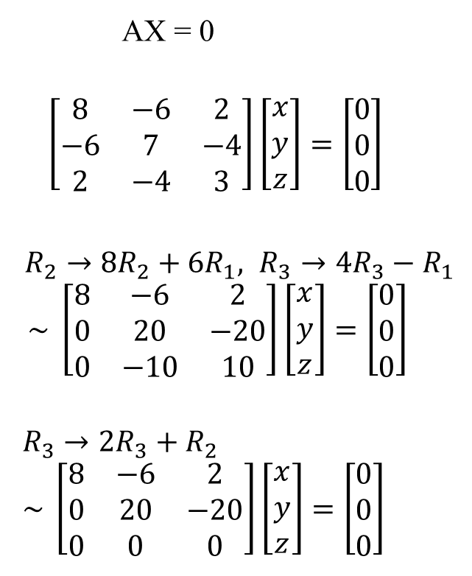
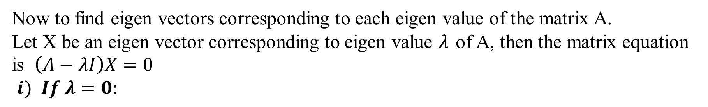
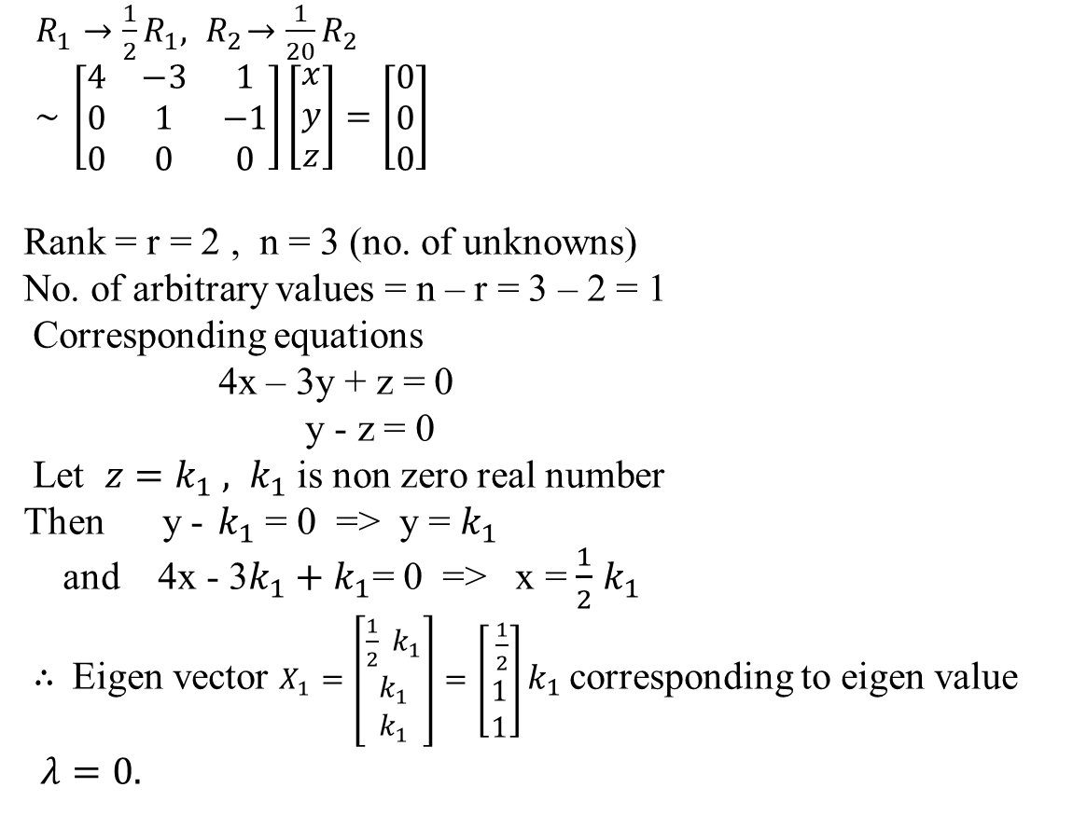
Now to find eigen vectors corresponding to each eigen value of the matrix A.
Let X be an eigen vector corresponding to eigen value $λ$of A, then the matrix equation is $\left(A−λI\right)X=0$
$i) If λ=0:$
$R_{1}→\frac{1}{2}R_{1}, { R}_{2}→\frac{1}{20}R_{2}$
$\sim \left[\begin{matrix}4 & −3 & 1 \\ 0 & 1 & −1 \\ 0 & 0 & 0\end{matrix}\right]\left[\begin{matrix}x \\ y \\ z\end{matrix}\right]=\left[\begin{matrix}0 \\ 0 \\ 0\end{matrix}\right]$
Rank = r = 2 , n = 3 (no. of unknowns)
No. of arbitrary values = n – r = 3 – 2 = 1
Corresponding equations
4x – 3y + z = 0
y - z = 0
Let $z=k_{1} , k_{1}$ is non zero real number
Then y -$k_{1}$ = 0 => y = $k_{1}$
and 4x - 3$k_{1}+k_{1}$= 0 => x = $\frac{1}{2}$$k_{1}$
$∴$Eigen vector $X_{1}=\left[\begin{matrix}\frac{1}{2} k_{1} \\ k_{1} \\ k_{1}\end{matrix}\right]=\left[\begin{matrix} \frac{1}{2} \\ 1 \\ 1\end{matrix}\right]k_{1}$corresponding to eigen value $λ=0.$
AX = 0
$\left[\begin{matrix}8 & −6 & 2 \\ −6 & 7 & −4 \\ 2 & −4 & 3\end{matrix}\right]\left[\begin{matrix}x \\ y \\ z\end{matrix}\right]=\left[\begin{matrix}0 \\ 0 \\ 0\end{matrix}\right]$
$R_{2}→{8R}_{2}+{6R}_{1}, R_{3}→4R_{3}−R_{1}$
$\sim \left[\begin{matrix}8 & −6 & 2 \\ 0 & 20 & −20 \\ 0 & −10 & 10\end{matrix}\right]\left[\begin{matrix}x \\ y \\ z\end{matrix}\right]=\left[\begin{matrix}0 \\ 0 \\ 0\end{matrix}\right]$
$R_{3}→2R_{3}+R_{2}$
$\sim \left[\begin{matrix}8 & −6 & 2 \\ 0 & 20 & −20 \\ 0 & 0 & 0\end{matrix}\right]\left[\begin{matrix}x \\ y \\ z\end{matrix}\right]=\left[\begin{matrix}0 \\ 0 \\ 0\end{matrix}\right]$

Slide 19
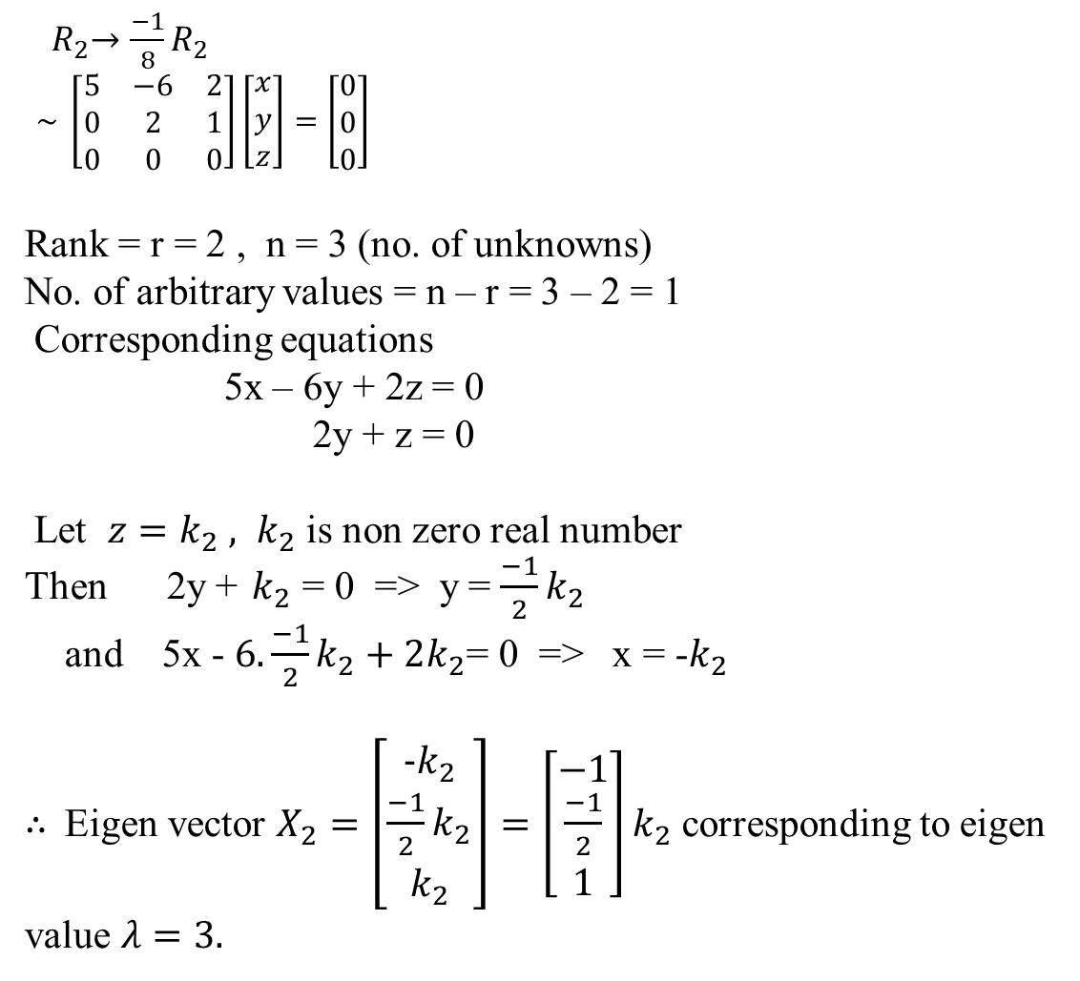
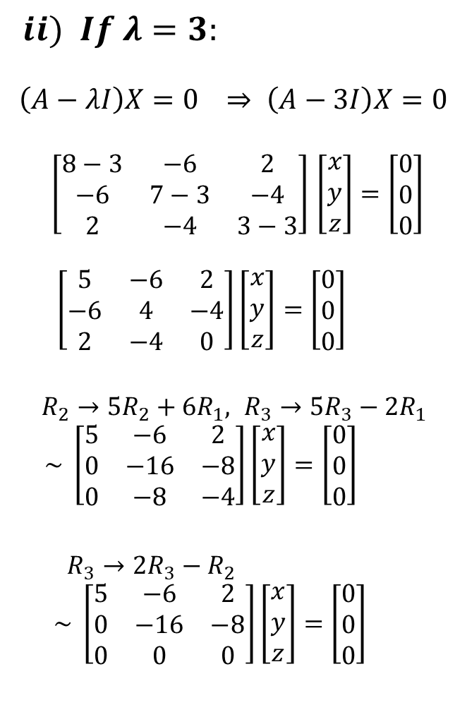
$ii) If λ=3:$
$$\left(A−λI\right)X=0 ⇒ \left(A−3I\right)X=0$$
$\left[\begin{matrix}8−3 & −6 & 2 \\ −6 & 7−3 & −4 \\ 2 & −4 & 3−3\end{matrix}\right]$$\left[\begin{matrix}x \\ y \\ z\end{matrix}\right]=\left[\begin{matrix}0 \\ 0 \\ 0\end{matrix}\right]$
$\left[\begin{matrix}5 & −6 & 2 \\ −6 & 4 & −4 \\ 2 & −4 & 0\end{matrix}\right]\left[\begin{matrix}x \\ y \\ z\end{matrix}\right]=\left[\begin{matrix}0 \\ 0 \\ 0\end{matrix}\right]$
$R_{2}→{5R}_{2}+{6R}_{1}, R_{3}→5R_{3}−{2R}_{1}$
$\sim \left[\begin{matrix}5 & −6 & 2 \\ 0 & −16 & −8 \\ 0 & −8 & −4\end{matrix}\right]\left[\begin{matrix}x \\ y \\ z\end{matrix}\right]=\left[\begin{matrix}0 \\ 0 \\ 0\end{matrix}\right]$
$R_{3}→2R_{3}−R_{2}$
$\sim \left[\begin{matrix}5 & −6 & 2 \\ 0 & −16 & −8 \\ 0 & 0 & 0\end{matrix}\right]\left[\begin{matrix}x \\ y \\ z\end{matrix}\right]=\left[\begin{matrix}0 \\ 0 \\ 0\end{matrix}\right]$
${ R}_{2}→\frac{−1}{8}R_{2}$
$\sim \left[\begin{matrix}5 & −6 & 2 \\ 0 & 2 & 1 \\ 0 & 0 & 0\end{matrix}\right]\left[\begin{matrix}x \\ y \\ z\end{matrix}\right]=\left[\begin{matrix}0 \\ 0 \\ 0\end{matrix}\right]$
Rank = r = 2 , n = 3 (no. of unknowns)
No. of arbitrary values = n – r = 3 – 2 = 1
Corresponding equations
5x – 6y + 2z = 0
2y + z = 0
Let $z=k_{2} , k_{2}$ is non zero real number
Then 2y +$k_{2}$ = 0 => y = $\frac{−1}{2}k_{2}$
and 5x - $6.\frac{−1}{2}k_{2}+2k_{2}$= 0 => x = -$k_{2}$
$∴$Eigen vector $X_{2}=\left[\begin{matrix}\text{−}k_{2} \\ \frac{−1}{2}k_{2} \\ k_{2}\end{matrix}\right]=\left[\begin{matrix}−1 \\ \frac{−1}{2} \\ 1\end{matrix}\right]k_{2}$ corresponding to eigen value $λ=3.$

Slide 20
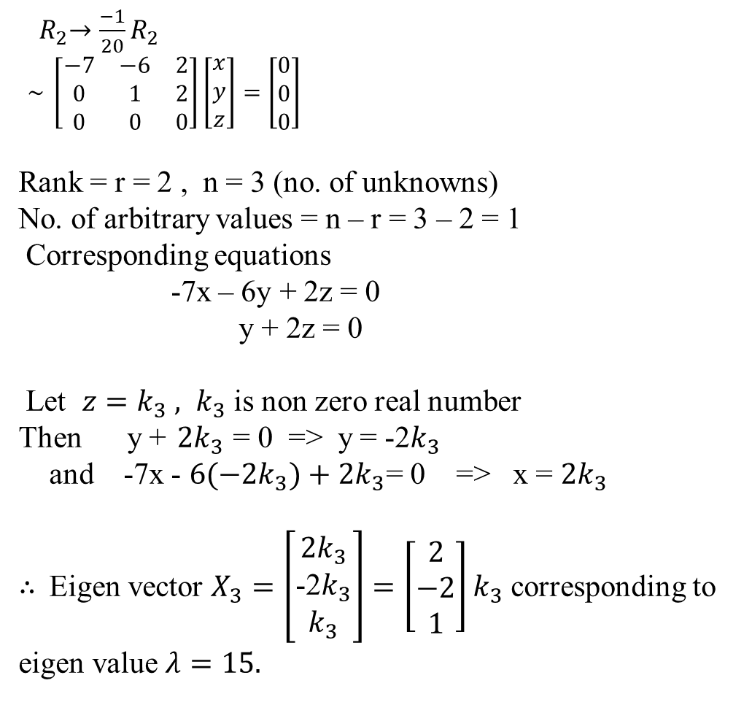
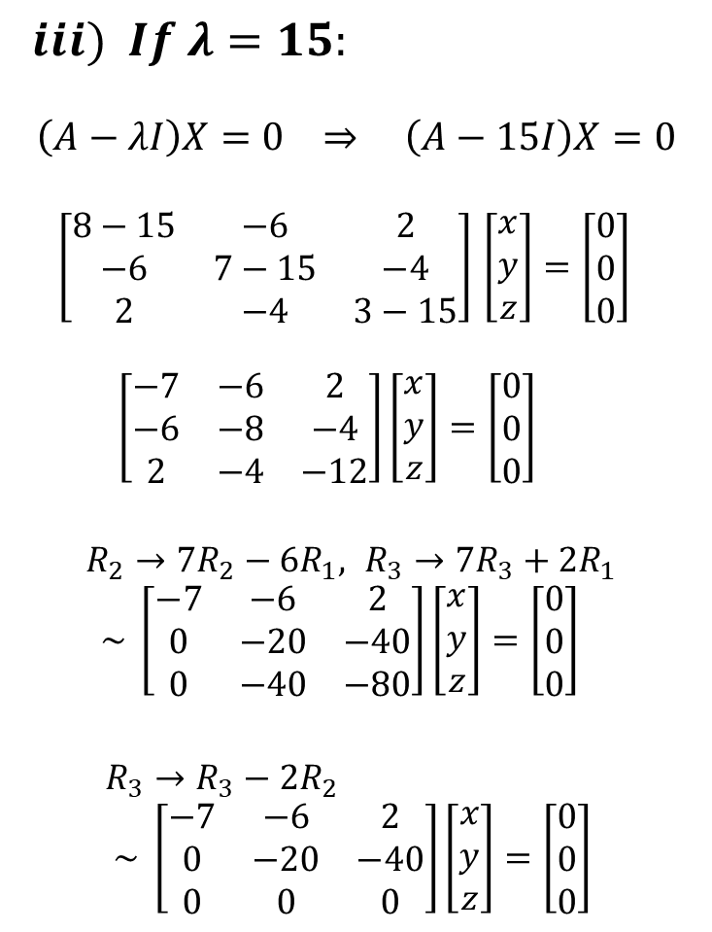
$iii) If λ=15:$
$$\left(A−λI\right)X=0 ⇒ \left(A−15I\right)X=0$$
$\left[\begin{matrix}8−15 & −6 & 2 \\ −6 & 7−15 & −4 \\ 2 & −4 & 3−15\end{matrix}\right]$$\left[\begin{matrix}x \\ y \\ z\end{matrix}\right]=\left[\begin{matrix}0 \\ 0 \\ 0\end{matrix}\right]$
$\left[\begin{matrix}−7 & −6 & 2 \\ −6 & −8 & −4 \\ 2 & −4 & −12\end{matrix}\right]\left[\begin{matrix}x \\ y \\ z\end{matrix}\right]=\left[\begin{matrix}0 \\ 0 \\ 0\end{matrix}\right]$
$R_{2}→{7R}_{2}−{6R}_{1}, R_{3}→7R_{3}+{2R}_{1}$
$\sim \left[\begin{matrix}−7 & −6 & 2 \\ 0 & −20 & −40 \\ 0 & −40 & −80\end{matrix}\right]\left[\begin{matrix}x \\ y \\ z\end{matrix}\right]=\left[\begin{matrix}0 \\ 0 \\ 0\end{matrix}\right]$
$R_{3}→R_{3}−{2R}_{2}$
$\sim \left[\begin{matrix}−7 & −6 & 2 \\ 0 & −20 & −40 \\ 0 & 0 & 0\end{matrix}\right]\left[\begin{matrix}x \\ y \\ z\end{matrix}\right]=\left[\begin{matrix}0 \\ 0 \\ 0\end{matrix}\right]$
${ R}_{2}→\frac{−1}{20}R_{2}$
$\sim \left[\begin{matrix}−7 & −6 & 2 \\ 0 & 1 & 2 \\ 0 & 0 & 0\end{matrix}\right]\left[\begin{matrix}x \\ y \\ z\end{matrix}\right]=\left[\begin{matrix}0 \\ 0 \\ 0\end{matrix}\right]$
Rank = r = 2 , n = 3 (no. of unknowns)
No. of arbitrary values = n – r = 3 – 2 = 1
Corresponding equations
-7x – 6y + 2z = 0
y + 2z = 0
Let $z=k_{3} , k_{3}$ is non zero real number
Then y +${2k}_{3}$ = 0 => y = -2$k_{3}$
and -7x - $6(−2k_{3})+2k_{3}$= 0 => x = $2k_{3}$
$∴$Eigen vector $X_{3}=\left[\begin{matrix}2k_{3} \\ \text{−2}k_{3} \\ k_{3}\end{matrix}\right]=\left[\begin{matrix}2 \\ −2 \\ 1\end{matrix}\right]k_{3}$ corresponding to eigen value $λ=15.$

Slide 21
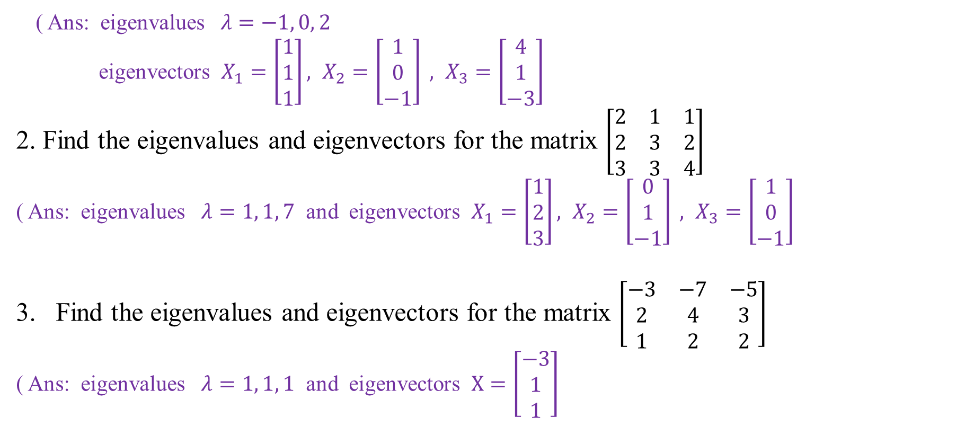

Practice Problems:
1. Find the eigenvalues and eigenvectors for the matrix $\left[\begin{matrix}9 & −1 & 9 \\ 3 & −1 & 3 \\ −7 & 1 & −7\end{matrix}\right]$
( Ans: eigenvalues $λ=−1, 0, 2$
eigenvectors $X_{1}=\left[\begin{matrix}1 \\ 1 \\ 1\end{matrix}\right], X_{2}=\left[\begin{matrix}1 \\ 0 \\ −1\end{matrix}\right] , X_{3}=\left[\begin{matrix}4 \\ 1 \\ −3\end{matrix}\right]$
2. Find the eigenvalues and eigenvectors for the matrix $\left[\begin{matrix}2 & 1 & 1 \\ 2 & 3 & 2 \\ 3 & 3 & 4\end{matrix}\right]$
( Ans: eigenvalues $λ=1, 1, 7$ and eigenvectors $X_{1}=\left[\begin{matrix}1 \\ 2 \\ 3\end{matrix}\right], X_{2}=\left[\begin{matrix}0 \\ 1 \\ −1\end{matrix}\right] , X_{3}=\left[\begin{matrix}1 \\ 0 \\ −1\end{matrix}\right]$
Find the eigenvalues and eigenvectors for the matrix $\left[\begin{matrix}−3 & −7 & −5 \\ 2 & 4 & 3 \\ 1 & 2 & 2\end{matrix}\right]$
( Ans: eigenvalues $λ=1, 1, 1$ and eigenvectors $X=\left[\begin{matrix}−3 \\ 1 \\ 1\end{matrix}\right]$

Slide 22
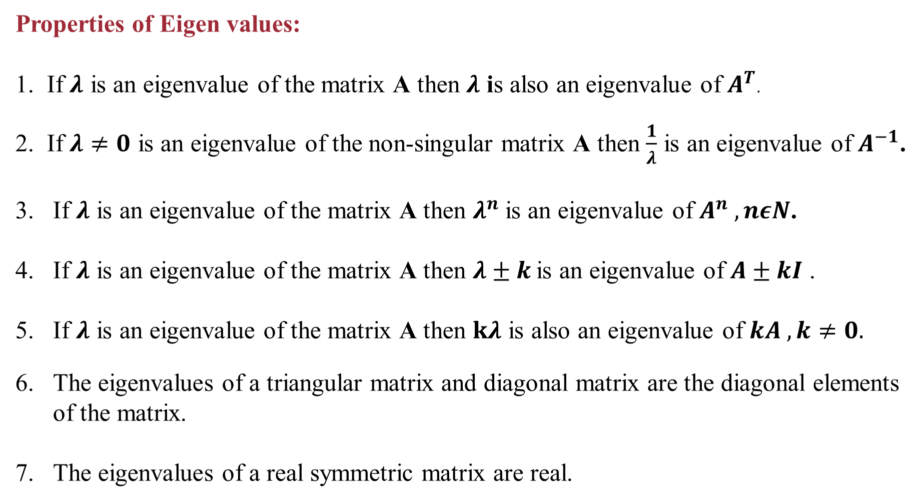
Properties of Eigen values:
1. If $λ$is an eigenvalue of the matrix A then $λ$is also an eigenvalue of $A^{T}$.
2. If $λ≠0$is an eigenvalue of the non-singular matrix A then $\frac{1}{λ}$is an eigenvalue of $A^{−1}$.
If $λ$is an eigenvalue of the matrix A then $λ^{n}$is an eigenvalue of $A^{n} , nεN$.
If $λ$is an eigenvalue of the matrix A then $λ±k$is an eigenvalue of $A±kI$.
If $λ$is an eigenvalue of the matrix A then $kλ$is also an eigenvalue of $kA , k≠0.$
The eigenvalues of a triangular matrix and diagonal matrix are the diagonal elements of the matrix.
The eigenvalues of a real symmetric matrix are real.

Slide 23
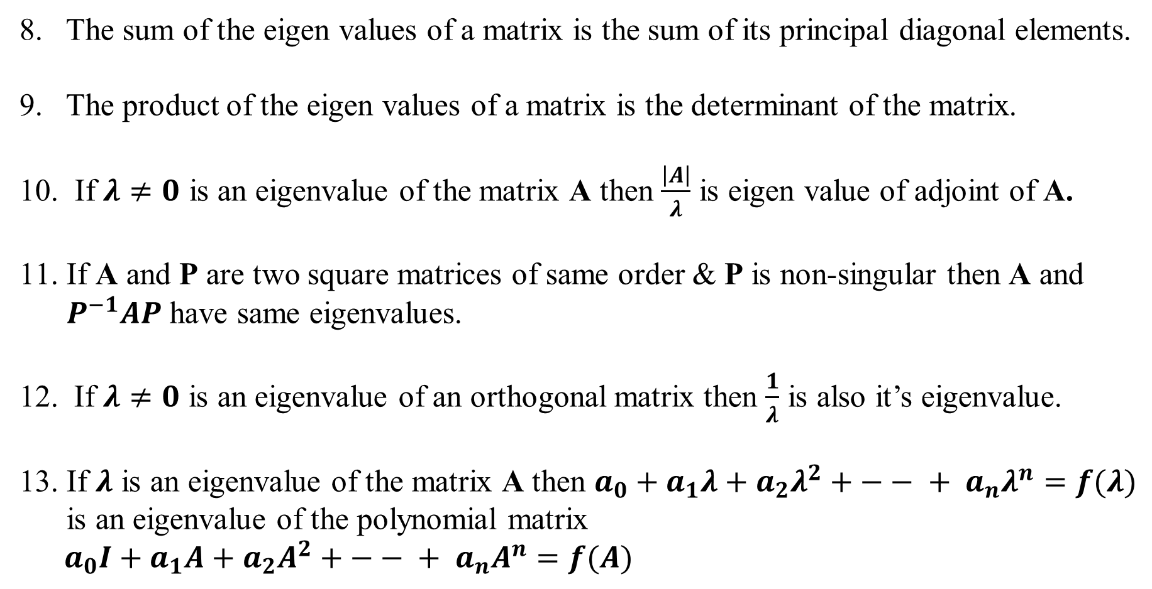
8. The sum of the eigen values of a matrix is the sum of its principal diagonal elements.
9. The product of the eigen values of a matrix is the determinant of the matrix.
10. If $λ≠0$is an eigenvalue of the matrix A then $\frac{\left|A\right|}{λ}$is eigen value of adjoint of A.
If A and P are two square matrices of same order &P is non-singular then A and $P^{−1}AP$have same eigenvalues.
If $λ≠0$ is an eigenvalue of an orthogonal matrix then $\frac{1}{λ}$is also it’s eigenvalue.
If $λ$is an eigenvalue of the matrix A then $a_{0}+a_{1}λ+a_{2}λ^{2}+ −− + a_{n}λ^{n}=f(λ)$
is an eigenvalue of the polynomial matrix
$a_{0}I+a_{1}A+a_{2}A^{2}+ −− + a_{n}A^{n}=f(A)$

Slide 24
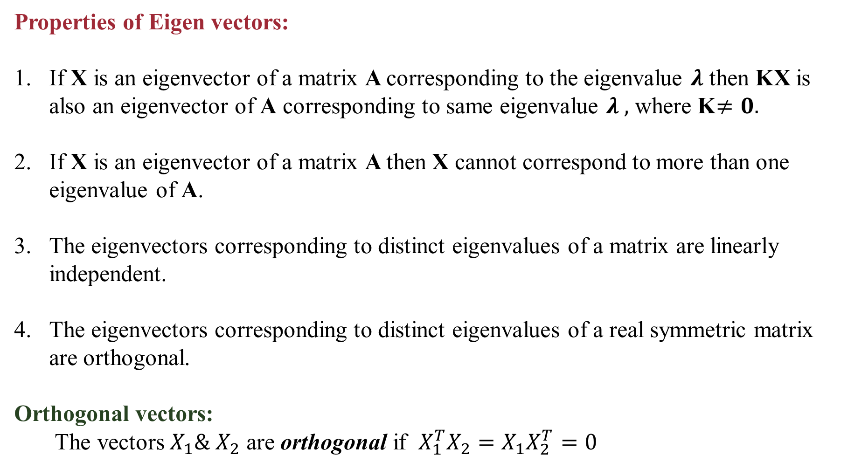
Properties of Eigen vectors:
If X is an eigenvector of a matrix A corresponding to the eigenvalue $λ$then KX is also an eigenvector of A corresponding to same eigenvalue $λ ,$ where K$≠0.$
If X is an eigenvector of a matrix A then X cannot correspond to more than one eigenvalue of A.
The eigenvectors corresponding to distinct eigenvalues of a matrix are linearly
independent.
The eigenvectors corresponding to distinct eigenvalues of a real symmetric matrix
are orthogonal.
Orthogonal vectors:
The vectors $X_{1}\&{ X}_{2}$ are orthogonal if $X_{1}^{T}X_{2}=X_{1}X_{2}^{T}=0$

Slide 25
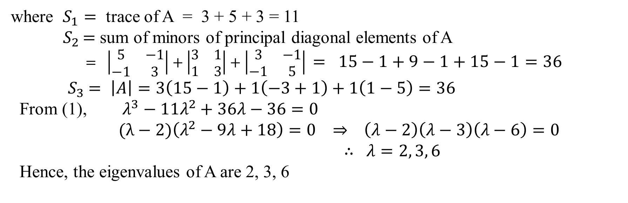
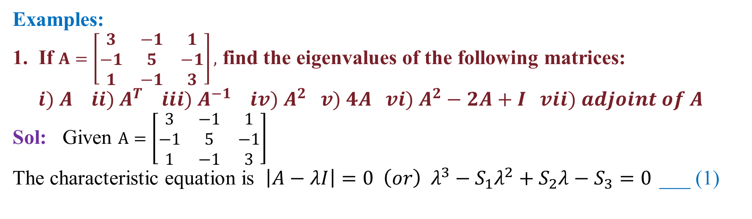
Examples:
1. If $A=\left[\begin{matrix}3 & −1 & 1 \\ −1 & 5 & −1 \\ 1 & −1 & 3\end{matrix}\right],$ find the eigenvalues of the following matrices:
$i) A ii) A^{T} iii) A^{−1} iv) A^{2} v) 4A vi) A^{2}−2A+I vii) adjoint of A$
Sol: Given $A=\left[\begin{matrix}3 & −1 & 1 \\ −1 & 5 & −1 \\ 1 & −1 & 3\end{matrix}\right]$
The characteristic equation is $\left|A−λI\right|=0 \left(or\right) λ^{3}−S_{1}λ^{2}+S_{2}λ−S_{3}=0$___ (1)
where $S_{1}=$ trace of A = 3 + 5 + 3 = 11
${ S}_{2 }=$ sum of minors of principal diagonal elements of A
$= \left|\begin{matrix}5 & −1 \\ −1 & 3\end{matrix}\right|+\left|\begin{matrix}3 & 1 \\ 1 & 3\end{matrix}\right|+\left|\begin{matrix}3 & −1 \\ −1 & 5\end{matrix}\right|$$= 15−1+9−1+15−1=36$
${ S}_{3} =$$\left|A\right|=3\left(15−1\right)+1\left(−3+1\right)+1\left(1−5\right)=36$
From (1), $λ^{3}−11λ^{2}+36λ−36=0$
$(λ−2)\left(λ^{2}−9λ+18\right)=0$$⇒ \left(λ−2\right)\left(λ−3\right)\left(λ−6\right)=0$
$∴ λ=2, 3, 6$
Hence, the eigenvalues of A are 2, 3, 6

Slide 26
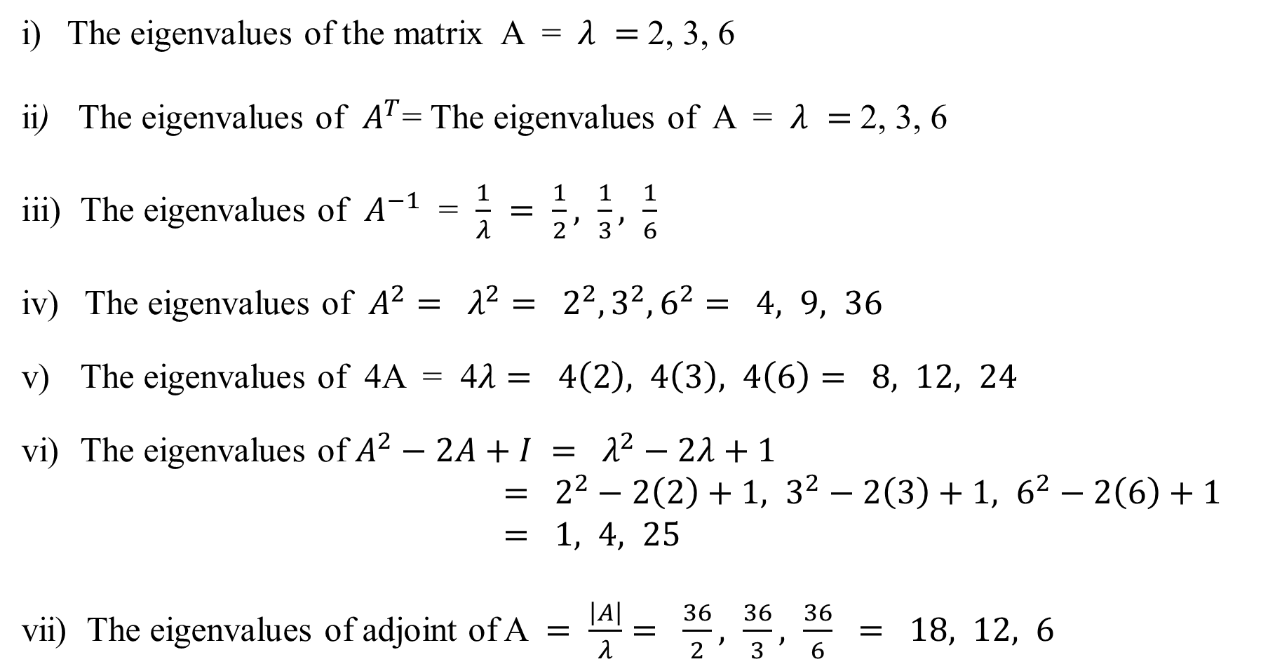
i) The eigenvalues of the matrix A = $λ =$2, 3, 6
ii) The eigenvalues of $A^{T}$= The eigenvalues of A = $λ =$2, 3, 6
The eigenvalues of $A^{−1}$ = $\frac{1}{λ} = \frac{1}{2}, \frac{1}{3}, \frac{1}{6}$
The eigenvalues of $A^{2}= λ^{2}= 2^{2}, 3^{2}, 6^{2}= 4, 9, 36$
The eigenvalues of 4A = 4$λ= 4\left(2\right), 4\left(3\right), 4\left(6\right)= 8, 12, 24$
The eigenvalues of $A^{2}−2A+I$$= λ^{2}−2λ+1$
$= 2^{2}−2\left(2\right)+1, 3^{2}−2\left(3\right)+1, 6^{2}−2\left(6\right)+1$
$= 1, 4, 25$
vii) The eigenvalues of adjoint of A $= \frac{\left|A\right|}{λ}= \frac{36}{2}, \frac{36}{3}, \frac{36}{6} = 18, 12, 6$

Slide 27
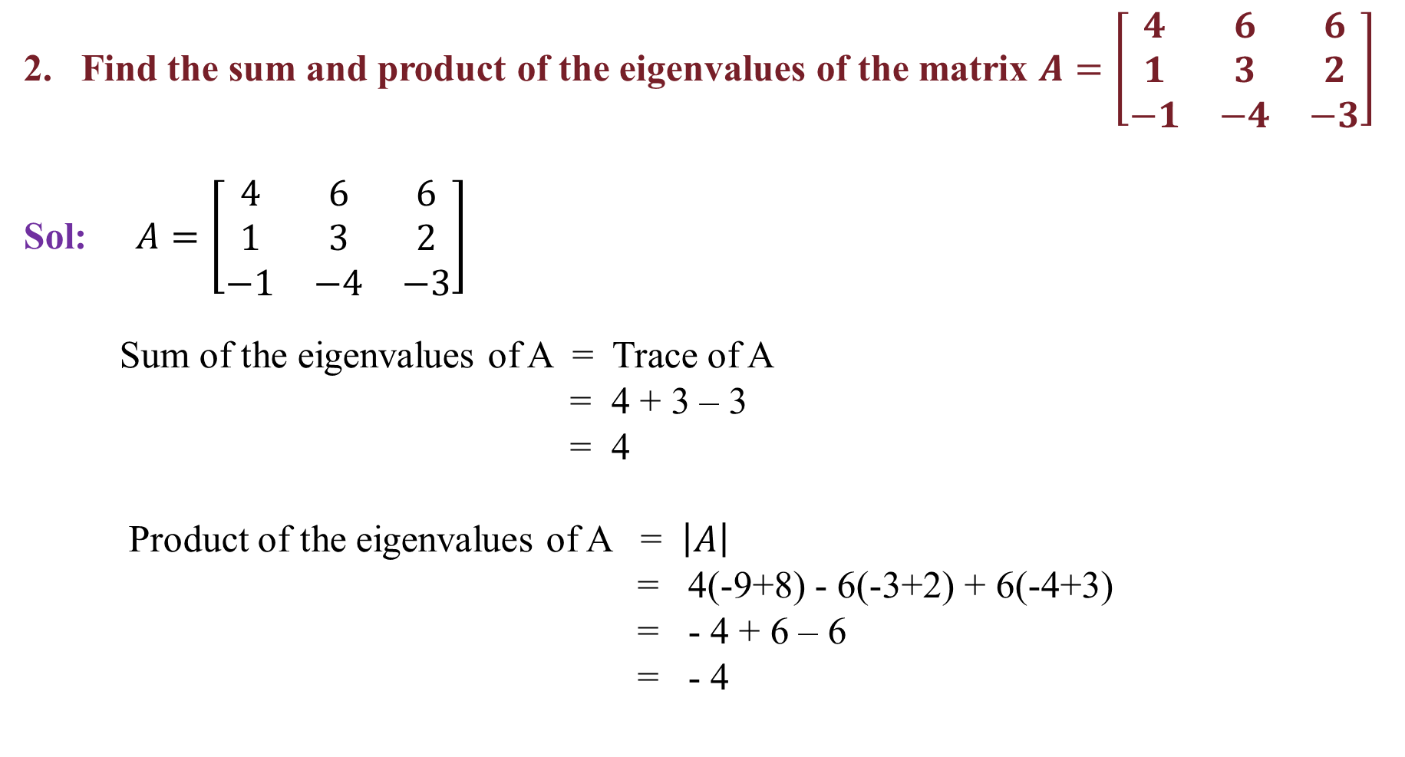
Find the sum and product of the eigenvalues of the matrix $A=\left[\begin{matrix}4 & 6 & 6 \\ 1 & 3 & 2 \\ −1 & −4 & −3\end{matrix}\right]$
Sol: $A=\left[\begin{matrix}4 & 6 & 6 \\ 1 & 3 & 2 \\ −1 & −4 & −3\end{matrix}\right]$
Sum of the eigenvalues of A = Trace of A
= 4 + 3 – 3
= 4
Product of the eigenvalues of A = $\left|A\right|$
= 4(-9+8) - 6(-3+2) + 6(-4+3)
= - 4 + 6 – 6
= - 4

Slide 28
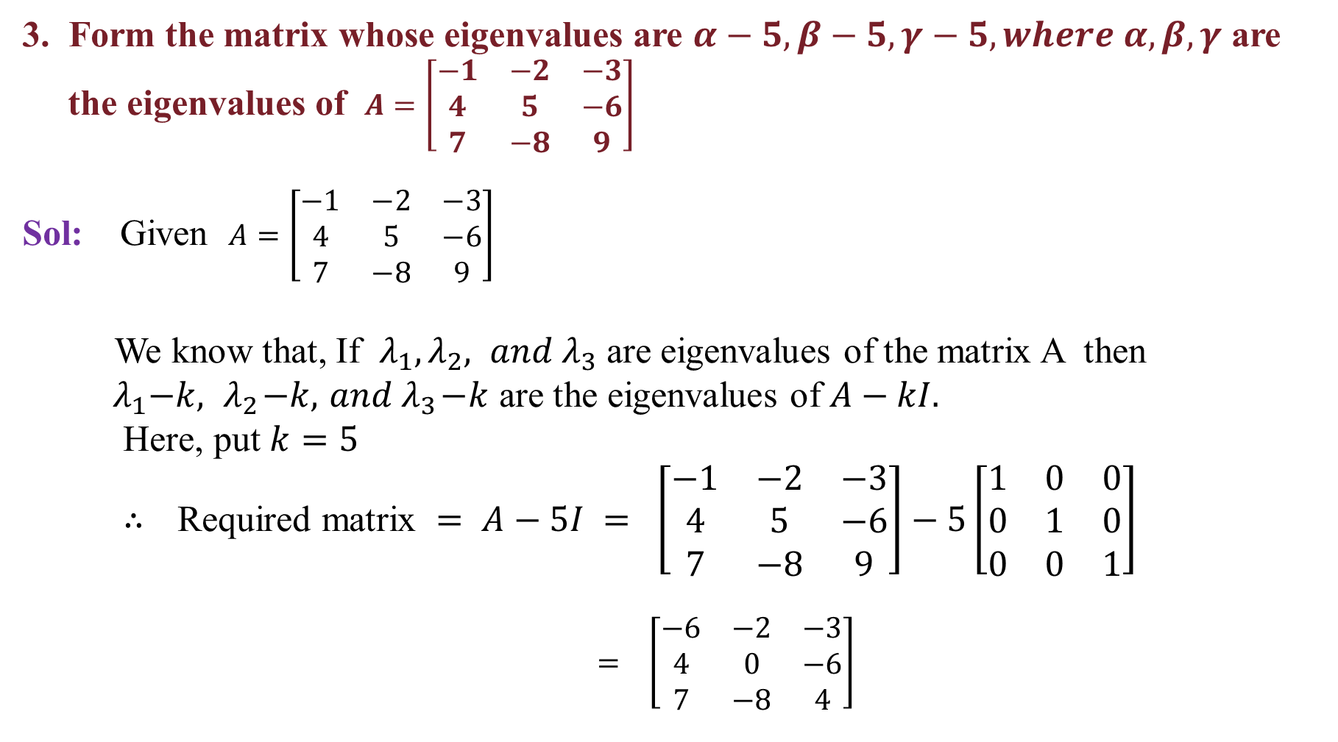
3. Form the matrix whose eigenvalues are $α−5, β−5, γ−5, where α, β, γ$are
the eigenvalues of $A=\left[\begin{matrix}−1 & −2 & −3 \\ 4 & 5 & −6 \\ 7 & −8 & 9\end{matrix}\right]$
Sol: Given $A=\left[\begin{matrix}−1 & −2 & −3 \\ 4 & 5 & −6 \\ 7 & −8 & 9\end{matrix}\right]$
We know that, If $λ_{1}, λ_{2}, and λ_{3}$ are eigenvalues of the matrix A then
${ λ}_{1}−k, { λ}_{2}−k, { and λ}_{3}−k$ are the eigenvalues of $A−kI.$
Here, put $k=5$
$∴$ Required matrix $= A−5I = \left[\begin{matrix}−1 & −2 & −3 \\ 4 & 5 & −6 \\ 7 & −8 & 9\end{matrix}\right]−5\left[\begin{matrix}1 & 0 & 0 \\ 0 & 1 & 0 \\ 0 & 0 & 1\end{matrix}\right]$
$= \left[\begin{matrix}−6 & −2 & −3 \\ 4 & 0 & −6 \\ 7 & −8 & 4\end{matrix}\right]$

Slide 29
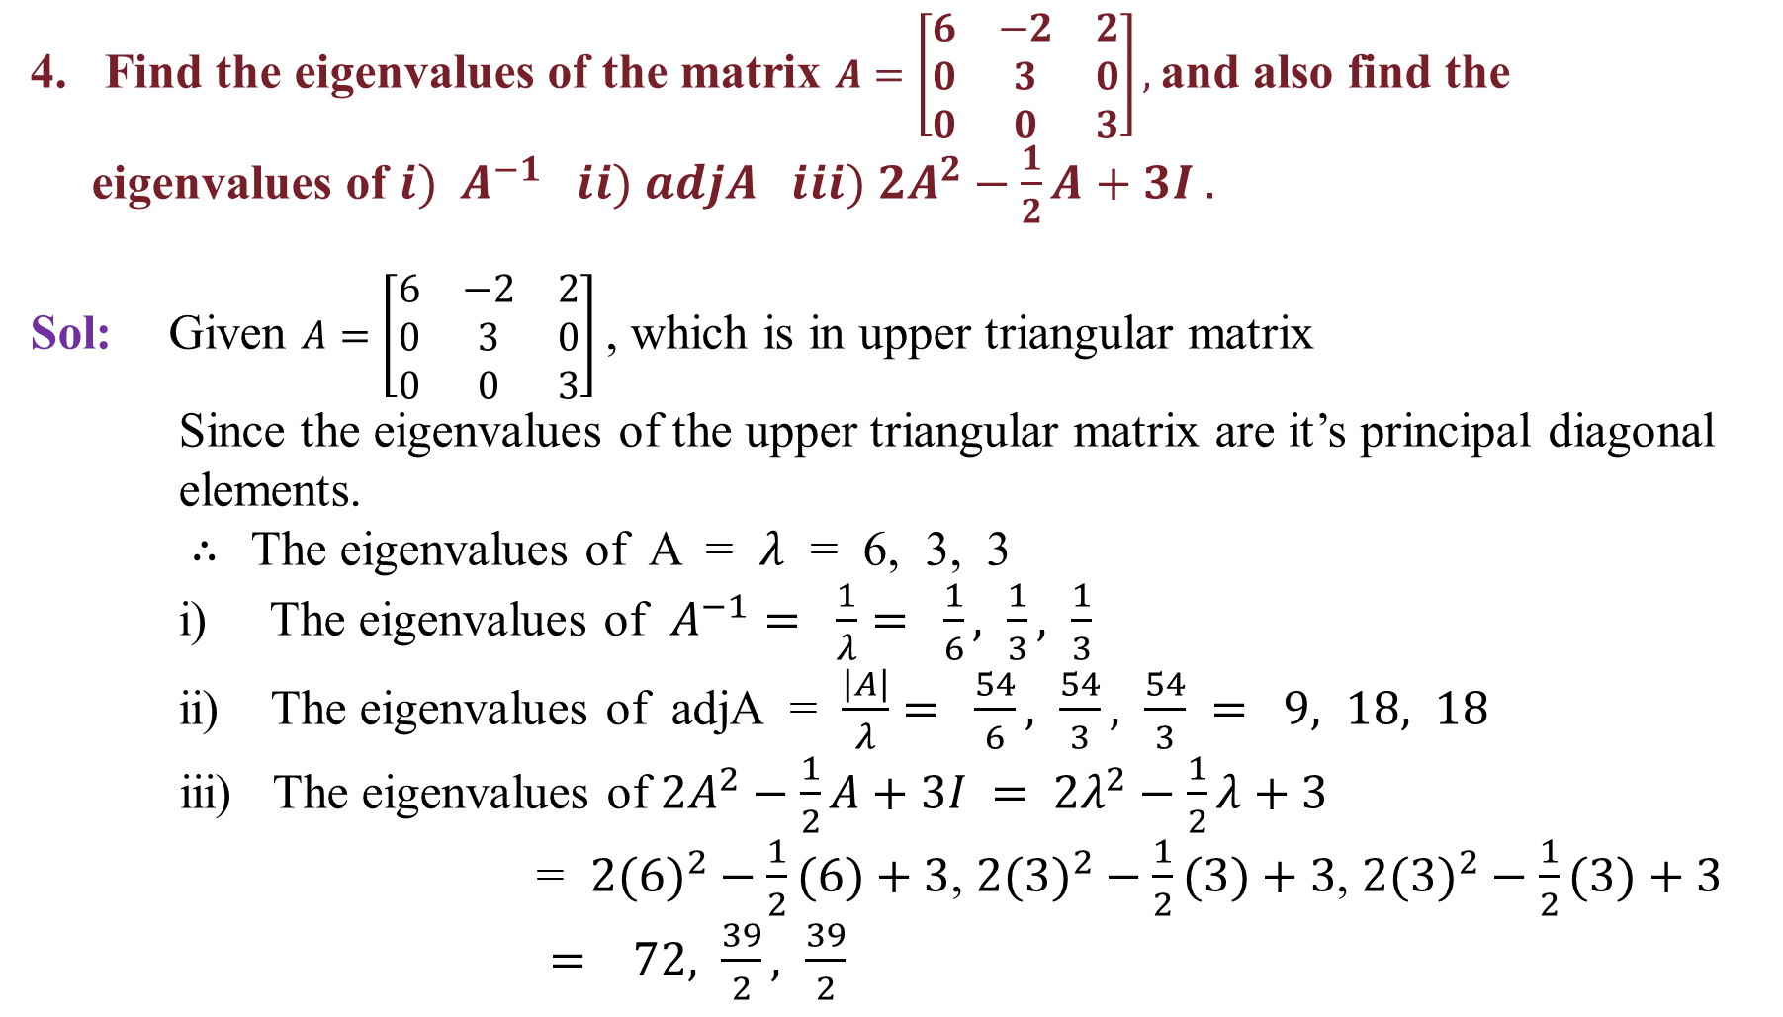
Find the eigenvalues of the matrix $A=\left[\begin{matrix}6 & −2 & 2 \\ 0 & 3 & 0 \\ 0 & 0 & 3\end{matrix}\right],$and also find the
eigenvalues of ${i) A}^{−1} ii) adjA iii) {2A}^{2}−\frac{1}{2}A+3I .$
Sol:Given $A=\left[\begin{matrix}6 & −2 & 2 \\ 0 & 3 & 0 \\ 0 & 0 & 3\end{matrix}\right]$, which is in upper triangular matrix
Since the eigenvalues of the upper triangular matrix are it’s principal diagonal
elements.
$∴$The eigenvalues of A = $λ$ = 6, 3, 3
i) The eigenvalues of $A^{−1}= \frac{1}{λ}= \frac{1}{6}, \frac{1}{3}, \frac{1}{3}$
ii) The eigenvalues of adjA = $\frac{\left|A\right|}{λ}= \frac{54}{6}, \frac{54}{3}, \frac{54}{3} = 9, 18, 18$
iii) The eigenvalues of ${2A}^{2}−\frac{1}{2}A+3I$$= {2λ}^{2}−\frac{1}{2}λ+3$
= ${2(6)}^{2}−\frac{1}{2}(6)+3$, ${2(3)}^{2}−\frac{1}{2}(3)+3$, ${2(3)}^{2}−\frac{1}{2}(3)+3$
$= 72, \frac{39}{2}, \frac{39}{2}$

Slide 30
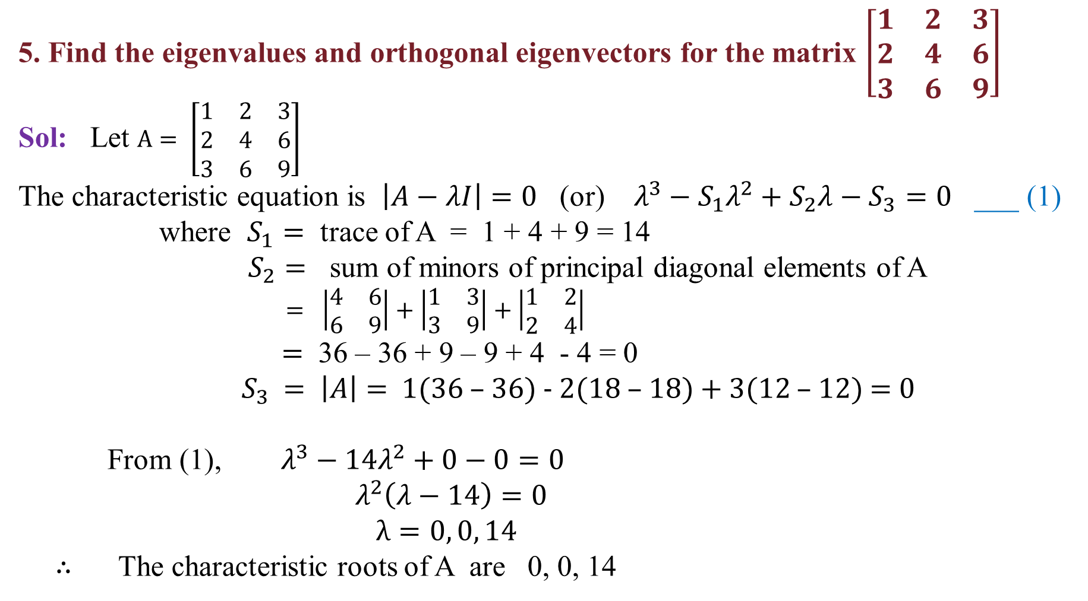
5. Find the eigenvalues and orthogonal eigenvectors for the matrix $\left[\begin{matrix}1 & 2 & 3 \\ 2 & 4 & 6 \\ 3 & 6 & 9\end{matrix}\right]$
Sol:Let $A= \left[\begin{matrix}1 & 2 & 3 \\ 2 & 4 & 6 \\ 3 & 6 & 9\end{matrix}\right]$
The characteristic equation is $\left|A−λI\right|=0$(or) $λ^{3}−S_{1}λ^{2}+S_{2}λ−S_{3}=0$ ___ (1)
where $S_{1}=$ trace of A = 1 + 4 + 9 = 14
$S_{2}=$ sum of minors of principal diagonal elements of A
$= \left|\begin{matrix}4 & 6 \\ 6 & 9\end{matrix}\right|+\left|\begin{matrix}1 & 3 \\ 3 & 9\end{matrix}\right|+\left|\begin{matrix}1 & 2 \\ 2 & 4\end{matrix}\right|$
$=$ 36 – 36 + 9 – 9 + 4 - 4 = 0
${ S}_{3} =$$\left|A\right|=$1(36 – 36) - 2(18 – 18) + 3(12 – 12) = 0
From (1), $λ^{3}−14λ^{2}+0−0=0$
$λ^{2}\left(λ−14\right)=0$
$λ=0, 0, 14$
$∴$ The characteristic roots of A are 0, 0, 14

Slide 31
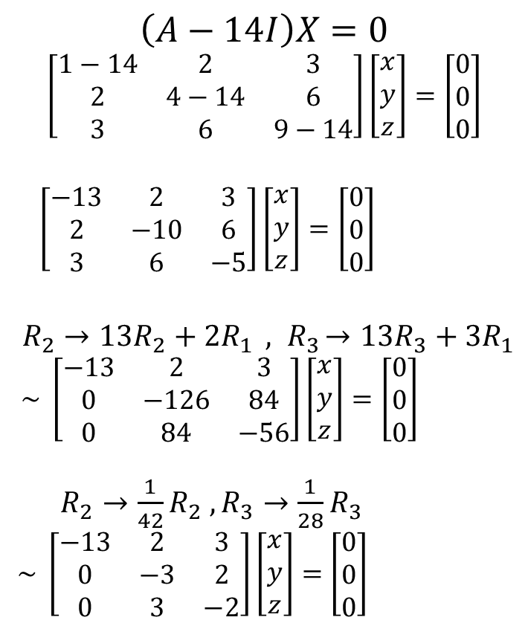
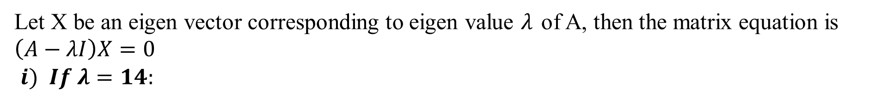
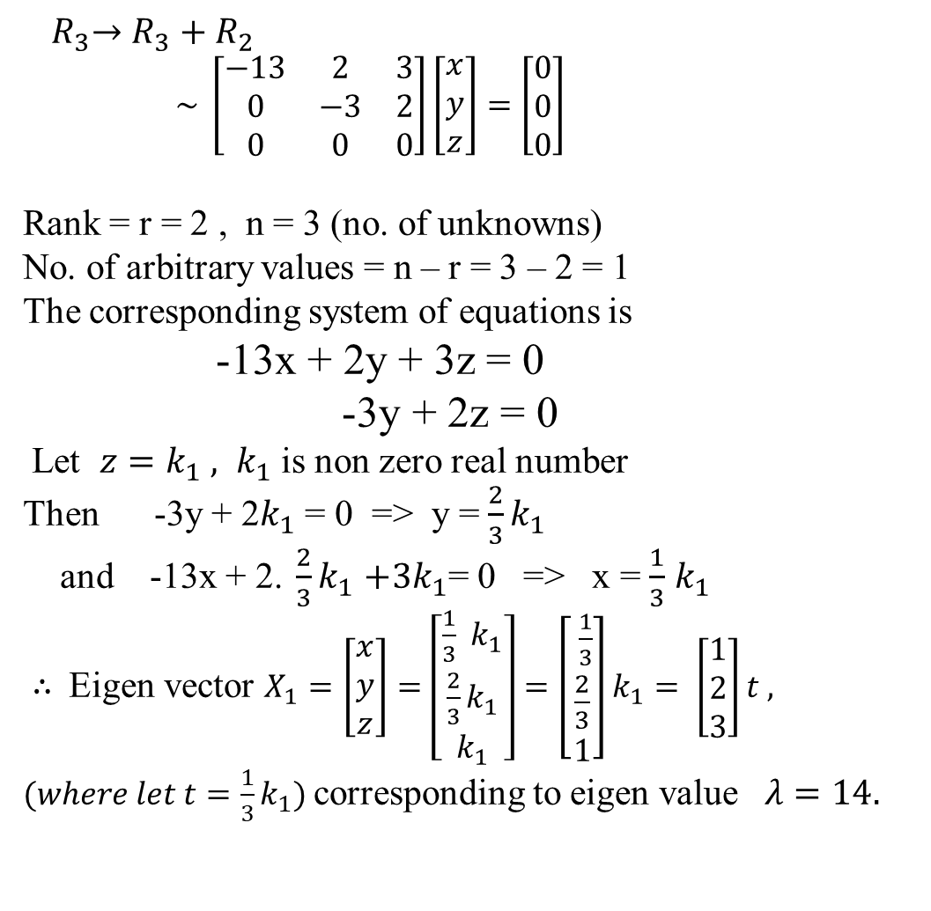
Let X be an eigen vector corresponding to eigen value $λ$of A, then the matrix equation is $\left(A−λI\right)X=0$
$i) If λ=14:$
${ R}_{3}→R_{3}+R_{2}$
$\sim \left[\begin{matrix}−13 & 2 & 3 \\ 0 & −3 & 2 \\ 0 & 0 & 0\end{matrix}\right]\left[\begin{matrix}x \\ y \\ z\end{matrix}\right]=\left[\begin{matrix}0 \\ 0 \\ 0\end{matrix}\right]$
Rank = r = 2 , n = 3 (no. of unknowns)
No. of arbitrary values = n – r = 3 – 2 = 1
The corresponding system of equations is
-13x + 2y + 3z = 0
-3y + 2z = 0
Let $z=k_{1} , k_{1}$ is non zero real number
Then -3y + 2$k_{1}$ = 0 => y = $\frac{2}{3}k_{1}$
and -13x + 2.$\frac{2}{3}k_{1}$$+3k_{1}$= 0 => x = $\frac{1}{3}$$k_{1}$
$∴$Eigen vector $X_{1}=\left[\begin{matrix}x \\ y \\ z\end{matrix}\right]=\left[\begin{matrix}\frac{1}{3} k_{1} \\ \frac{2}{3}k_{1} \\ k_{1}\end{matrix}\right]=\left[\begin{matrix} \frac{1}{3} \\ \frac{2}{3} \\ 1\end{matrix}\right]k_{1}= \left[\begin{matrix}1 \\ 2 \\ 3\end{matrix}\right]t ,$
$(where let t=\frac{1}{3}k_{1})$corresponding to eigen value $λ=14.$
$$\left(A−14I\right)X=0$$
$$\left[\begin{matrix}1−14 & 2 & 3 \\ 2 & 4−14 & 6 \\ 3 & 6 & 9−14\end{matrix}\right]\left[\begin{matrix}x \\ y \\ z\end{matrix}\right]=\left[\begin{matrix}0 \\ 0 \\ 0\end{matrix}\right]$$
$\left[\begin{matrix}−13 & 2 & 3 \\ 2 & −10 & 6 \\ 3 & 6 & −5\end{matrix}\right]\left[\begin{matrix}x \\ y \\ z\end{matrix}\right]=\left[\begin{matrix}0 \\ 0 \\ 0\end{matrix}\right]$
$R_{2}→13R_{2}+{2R}_{1}{ , R}_{3}→13R_{3}+{3R}_{1}$
$\sim \left[\begin{matrix}−13 & 2 & 3 \\ 0 & −126 & 84 \\ 0 & 84 & −56\end{matrix}\right]\left[\begin{matrix}x \\ y \\ z\end{matrix}\right]=\left[\begin{matrix}0 \\ 0 \\ 0\end{matrix}\right]$
$R_{2}→\frac{1}{42}R_{2} ,R_{3}→\frac{1}{28}R_{3}$
$\sim \left[\begin{matrix}−13 & 2 & 3 \\ 0 & −3 & 2 \\ 0 & 3 & −2\end{matrix}\right]\left[\begin{matrix}x \\ y \\ z\end{matrix}\right]=\left[\begin{matrix}0 \\ 0 \\ 0\end{matrix}\right]$

Slide 32
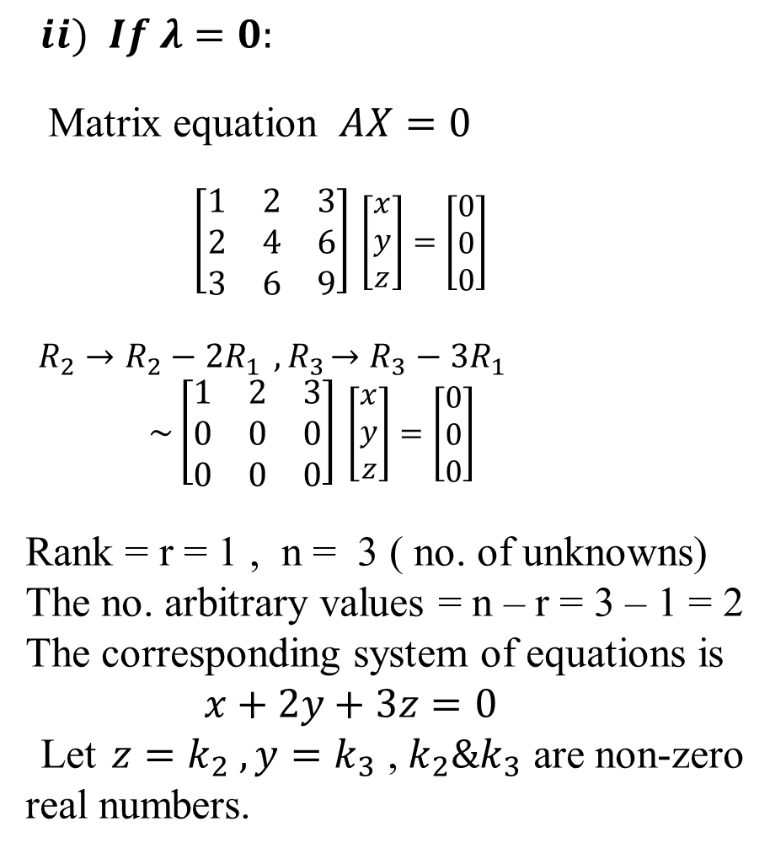
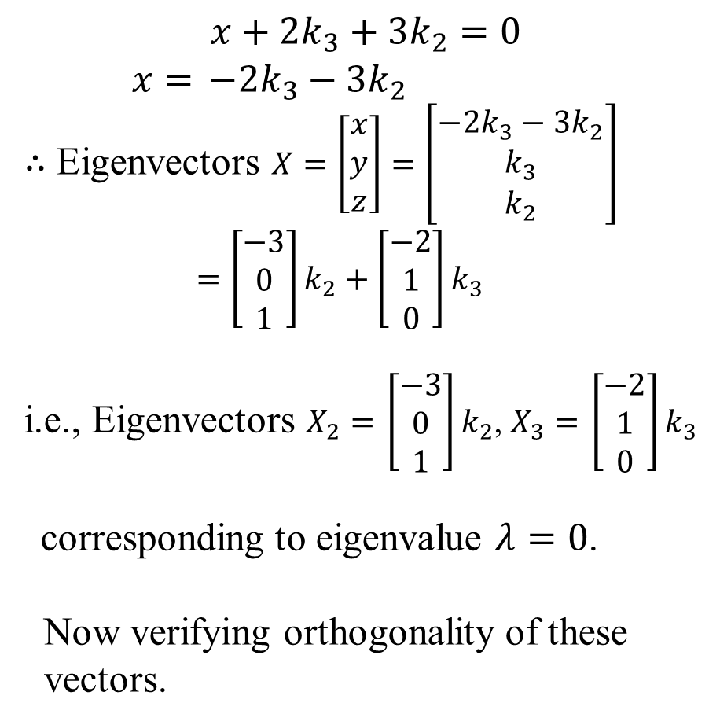
$ii) If λ=0:$
Matrix equation $AX=0$
$\left[\begin{matrix}1 & 2 & 3 \\ 2 & 4 & 6 \\ 3 & 6 & 9\end{matrix}\right]$$\left[\begin{matrix}x \\ y \\ z\end{matrix}\right]=\left[\begin{matrix}0 \\ 0 \\ 0\end{matrix}\right]$
$R_{2}→R_{2}−{2R}_{1}{ , R}_{3}→R_{3}−{3R}_{1}$
$\sim \left[\begin{matrix}1 & 2 & 3 \\ 0 & 0 & 0 \\ 0 & 0 & 0\end{matrix}\right]$$\left[\begin{matrix}x \\ y \\ z\end{matrix}\right]=\left[\begin{matrix}0 \\ 0 \\ 0\end{matrix}\right]$
Rank = r = 1 , n = 3 ( no. of unknowns)
The no. arbitrary values = n – r = 3 – 1 = 2
The corresponding system of equations is
$x+2y+3z=0$
Let$z=k_{2} , y=k_{3}$ , $k_{2}\&k_{3}$ are non-zero real numbers.
$$x+2k_{3}+3k_{2}=0$$
$x=$$−2k_{3}−3k_{2}$
$∴$ Eigenvectors $X=\left[\begin{matrix}x \\ y \\ z\end{matrix}\right]=\left[\begin{matrix}−2k_{3}−3k_{2} \\ k_{3} \\ k_{2}\end{matrix}\right]$
$=\left[\begin{matrix}−3 \\ 0 \\ 1\end{matrix}\right]k_{2}+\left[\begin{matrix}−2 \\ 1 \\ 0\end{matrix}\right]k_{3}$
i.e., Eigenvectors $X_{2}=$$\left[\begin{matrix}−3 \\ 0 \\ 1\end{matrix}\right]k_{2}$, $X_{3}=$$\left[\begin{matrix}−2 \\ 1 \\ 0\end{matrix}\right]k_{3}$
corresponding to eigenvalue $λ=0$.
Now verifying orthogonality of these
vectors.

Slide 33
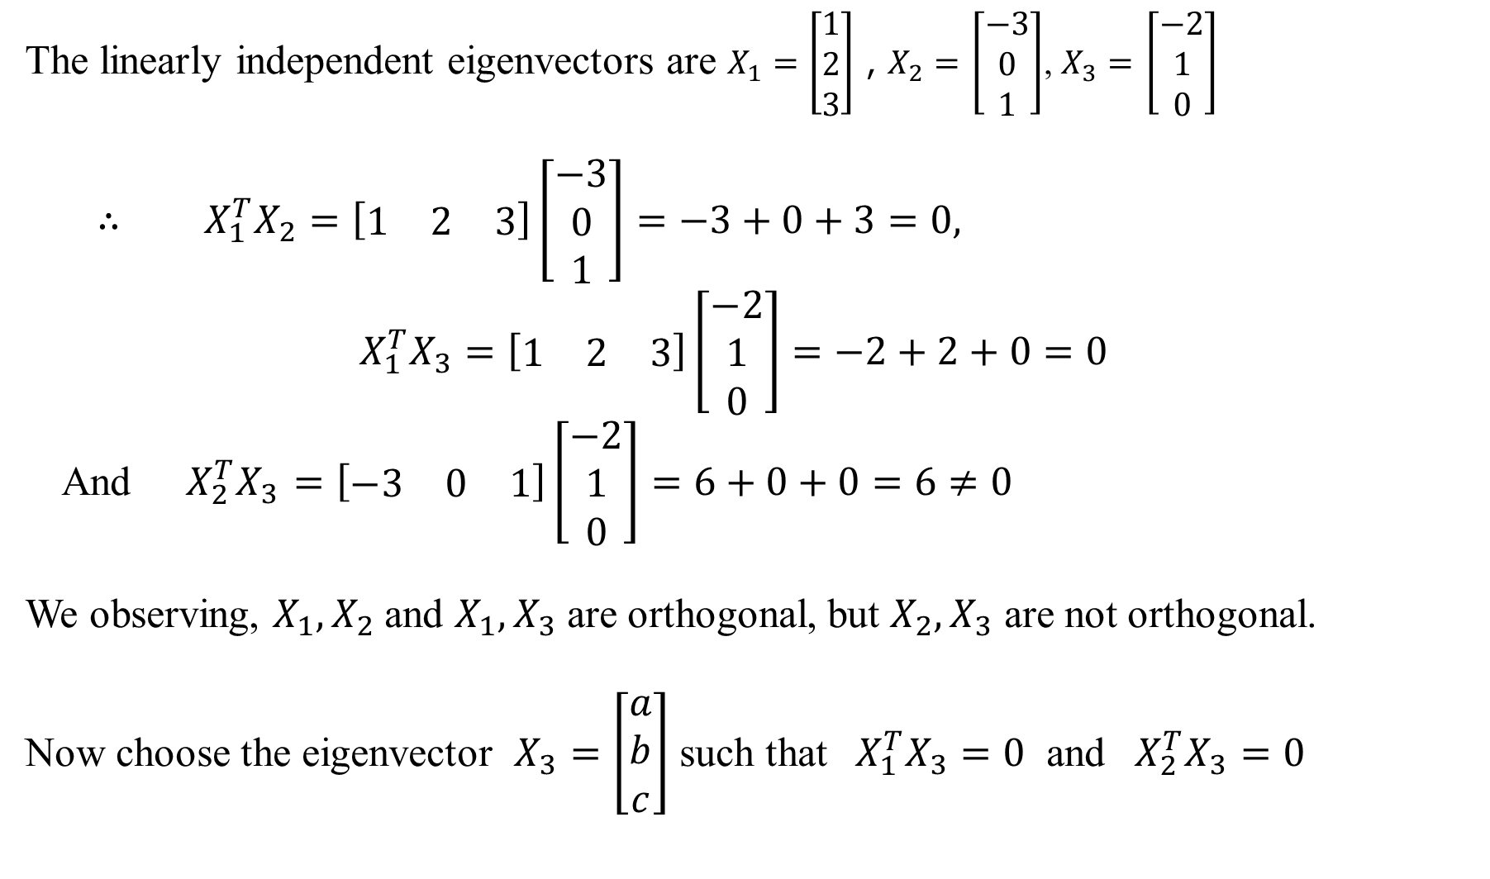
The linearly independent eigenvectors are $X_{1}=\left[\begin{matrix}1 \\ 2 \\ 3\end{matrix}\right]$ , $X_{2}=$$\left[\begin{matrix}−3 \\ 0 \\ 1\end{matrix}\right]$, $X_{3}=$$\left[\begin{matrix}−2 \\ 1 \\ 0\end{matrix}\right]$
$∴ X_{1}^{T}X_{2}=\left[\begin{matrix}1 & 2 & 3\end{matrix}\right]\left[\begin{matrix}−3 \\ 0 \\ 1\end{matrix}\right]=−3+0+3=0,$
${ X}_{1}^{T}X_{3}=\left[\begin{matrix}1 & 2 & 3\end{matrix}\right]\left[\begin{matrix}−2 \\ 1 \\ 0\end{matrix}\right]=−2+2+0=0$
And ${ X}_{2}^{T}X_{3}$$=\left[\begin{matrix}−3 & 0 & 1\end{matrix}\right]\left[\begin{matrix}−2 \\ 1 \\ 0\end{matrix}\right]=6+0+0=6≠0$
We observing, $X_{1}, X_{2}$and $X_{1}, X_{3}$ are orthogonal, but $X_{2}, X_{3}$ are not orthogonal.
Now choose the eigenvector $X_{3}=\left[\begin{matrix}a \\ b \\ c\end{matrix}\right]$ such that ${ X}_{1}^{T}X_{3}=0$ and ${ X}_{2}^{T}X_{3}=0$

Slide 34
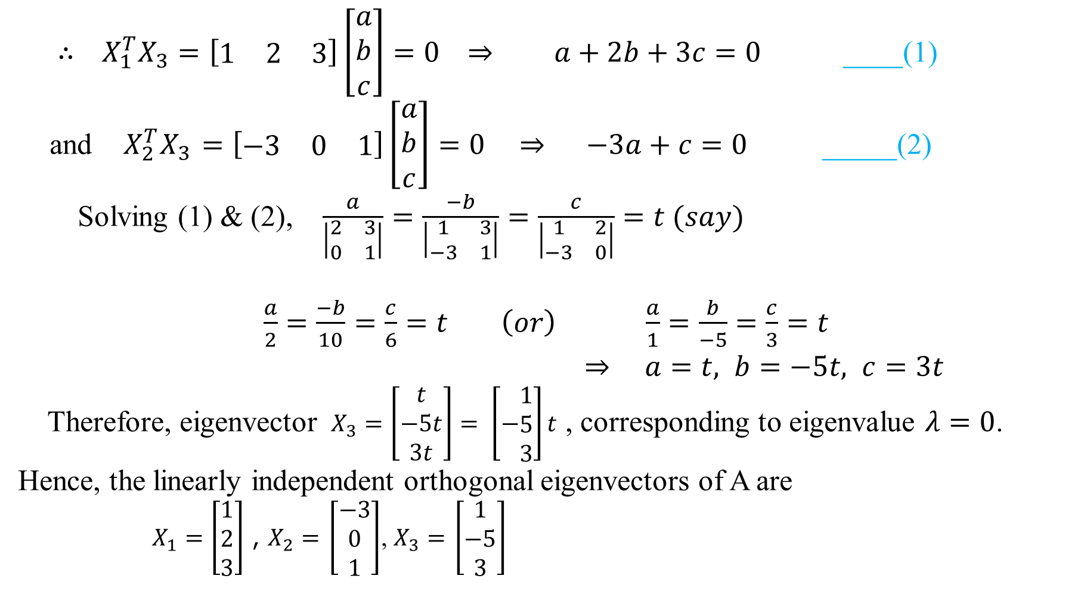
$∴ X_{1}^{T}X_{3}=\left[\begin{matrix}1 & 2 & 3\end{matrix}\right]\left[\begin{matrix}a \\ b \\ c\end{matrix}\right]=0 ⇒ a+2b+3c=0$____(1)
and ${ X}_{2}^{T}X_{3}$$=\left[\begin{matrix}−3 & 0 & 1\end{matrix}\right]\left[\begin{matrix}a \\ b \\ c\end{matrix}\right]=0 ⇒ −3a+c=0$_____(2)
Solving (1) & (2), $\frac{a}{\left|\begin{matrix}2 & 3 \\ 0 & 1\end{matrix}\right|}=\frac{−b}{\left|\begin{matrix}1 & 3 \\ −3 & 1\end{matrix}\right|}=\frac{c}{\left|\begin{matrix}1 & 2 \\ −3 & 0\end{matrix}\right|}=t (say)$
$\frac{a}{2}=\frac{−b}{10}=\frac{c}{6}=t \left(or\right) \frac{a}{1}=\frac{b}{−5}=\frac{c}{3}=t$
$⇒ a=t, b=−5t, c=3t$
Therefore, eigenvector $X_{3}=\left[\begin{matrix}t \\ −5t \\ 3t\end{matrix}\right]= \left[−\begin{matrix}1 \\ 5 \\ 3\end{matrix}\right]t$ , corresponding to eigenvalue $λ=0$.
Hence, the linearly independent orthogonal eigenvectors of A are
$X_{1}=\left[\begin{matrix}1 \\ 2 \\ 3\end{matrix}\right]$ , $X_{2}=$$\left[\begin{matrix}−3 \\ 0 \\ 1\end{matrix}\right]$, $X_{3}=$$\left[\begin{matrix}1 \\ −5 \\ 3\end{matrix}\right]$

Slide 35
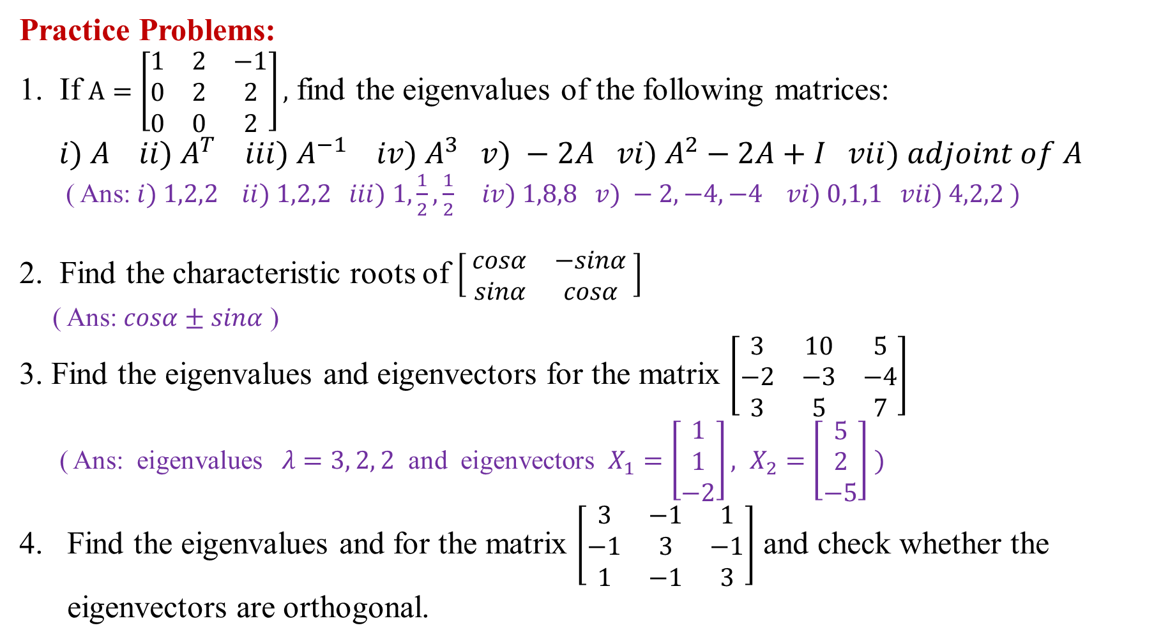
Practice Problems:
1. If $A=\left[\begin{matrix}1 & 2 & −1 \\ 0 & 2 & 2 \\ 0 & 0 & 2\end{matrix}\right],$ find the eigenvalues of the following matrices:
$i) A ii) A^{T} iii) A^{−1} iv) A^{3} v) −2A vi) A^{2}−2A+I vii) adjoint of A$
( Ans: $i) 1,2,2 ii) 1,2,2 iii) 1,\frac{1}{2},\frac{1}{2} iv) 1,8,8 v) −2,−4,−4 vi) 0,1,1 vii) 4,2,2 )$
2. Find the characteristic roots of $\left[ \begin{matrix}cosα & −sinα \\ sinα & cosα\end{matrix} \right]$
( Ans: $cosα±sinα$ )
3. Find the eigenvalues and eigenvectors for the matrix $\left[\begin{matrix}3 & 10 & 5 \\ −2 & −3 & −4 \\ 3 & 5 & 7\end{matrix}\right]$
( Ans: eigenvalues $λ=3, 2, 2$ and eigenvectors $X_{1}=\left[\begin{matrix}1 \\ 1 \\ −2\end{matrix}\right], X_{2}=\left[\begin{matrix}5 \\ 2 \\ −5\end{matrix}\right] )$
Find the eigenvalues and for the matrix $\left[\begin{matrix}3 & −1 & 1 \\ −1 & 3 & −1 \\ 1 & −1 & 3\end{matrix}\right]$ and check whether the
eigenvectors are orthogonal.

Slide 36
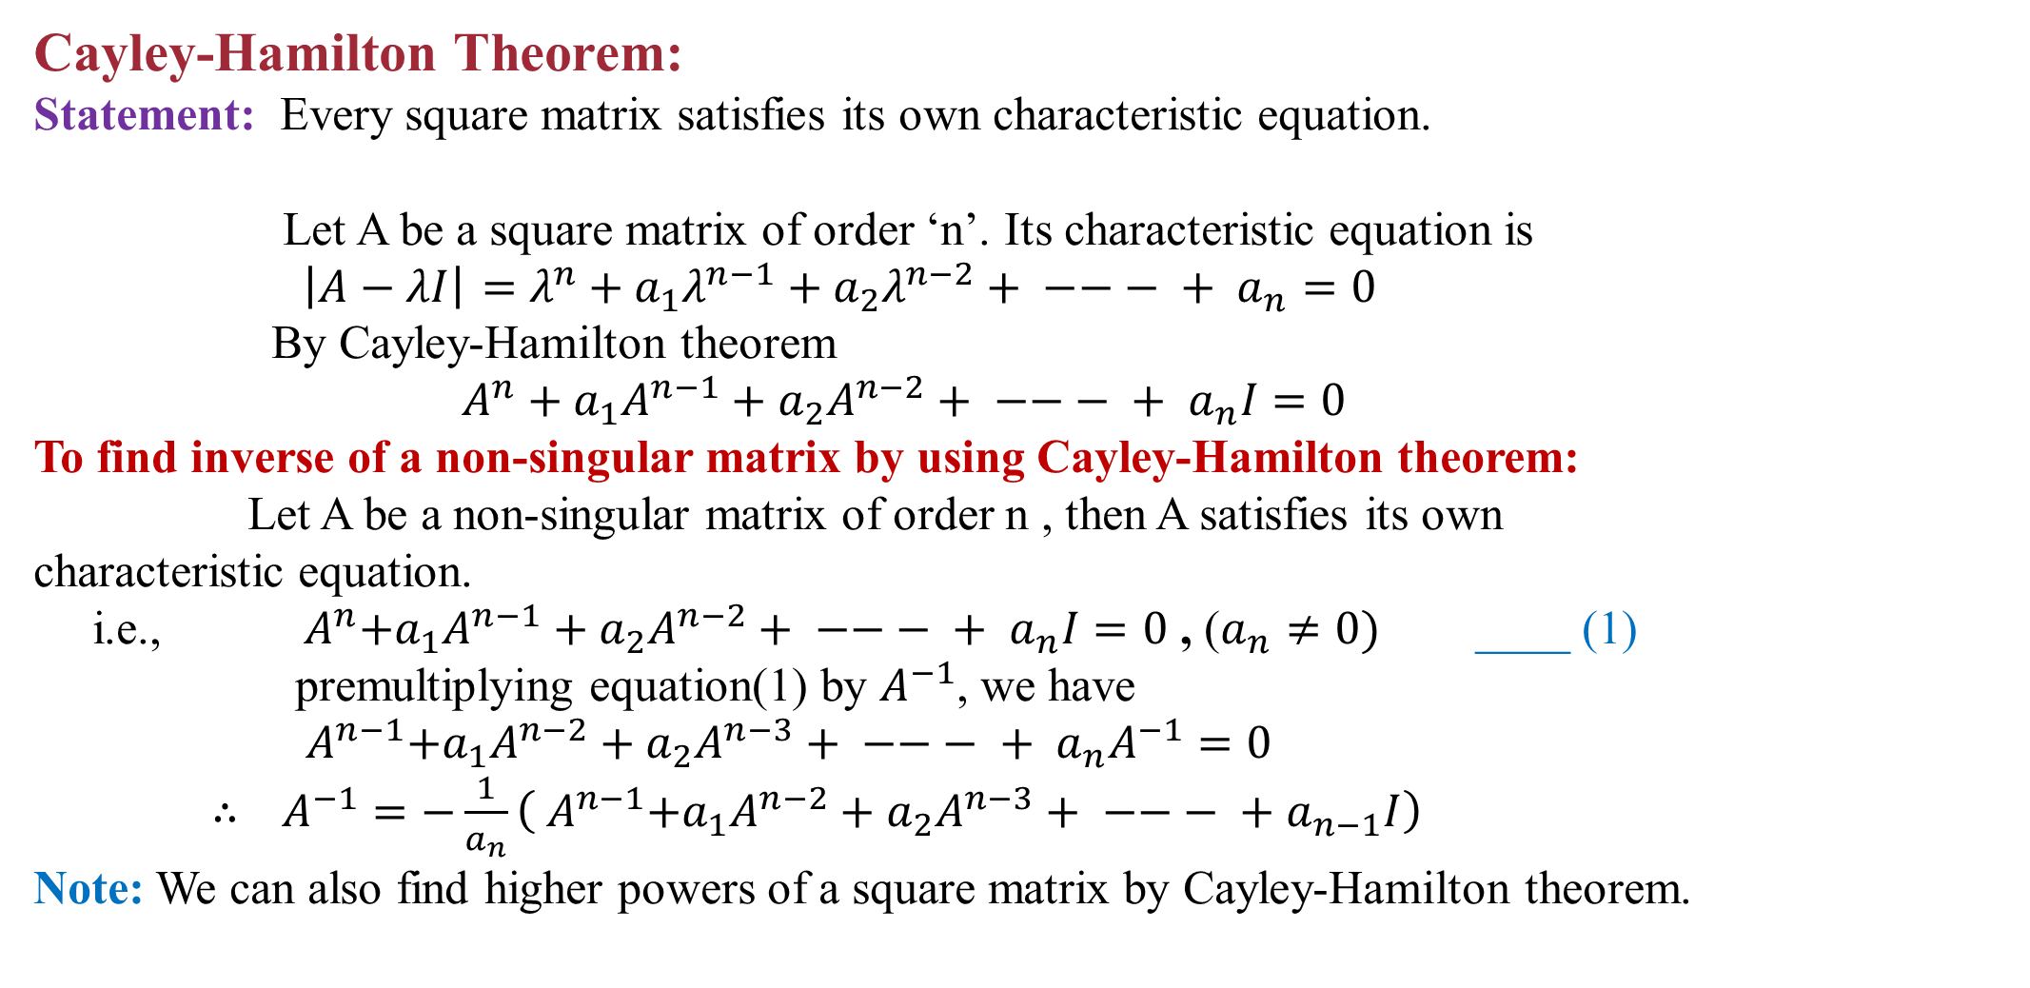
Cayley-Hamilton Theorem:
Statement:Every square matrix satisfies its own characteristic equation.
Let A be a square matrix of order ‘n’. Its characteristic equation is
$\left|A−λI\right|$$=$$λ^{n}+a_{1}λ^{n−1}+a_{2}λ^{n−2}+ −−− + a_{n}=0$
By Cayley-Hamilton theorem
$A^{n}+a_{1}A^{n−1}+a_{2}A^{n−2}+ −−− + a_{n}I=0$
To find inverse of a non-singular matrix by using Cayley-Hamilton theorem:
Let A be a non-singular matrix of order n , then A satisfies its own
characteristic equation.
i.e., ${ A}^{n}+a_{1}A^{n−1}+a_{2}A^{n−2}+ −−− + a_{n}I=0$,($a_{n}≠0)$____ (1)
premultiplying equation(1) by $A^{−1}$, we have
${ A}^{n−1}+a_{1}A^{n−2}+a_{2}A^{n−3}+ −−− + a_{n}A^{−1}=0$
$∴$$A^{−1}=−\frac{1}{a_{n}}\left({ A}^{n−1}+a_{1}A^{n−2}+a_{2}A^{n−3}+ −−− +a_{n−1}I\right)$
Note: We can also find higher powers of a square matrix by Cayley-Hamilton theorem.

Slide 37
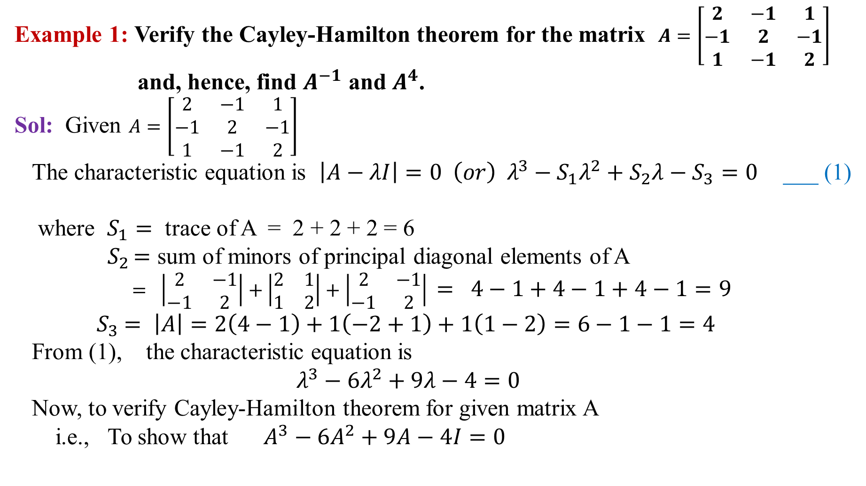
Example 1: Verify the Cayley-Hamilton theorem for the matrix $A=\left[\begin{matrix}2 & −1 & 1 \\ −1 & 2 & −1 \\ 1 & −1 & 2\end{matrix}\right]$
and, hence, find $A^{−1}$ and $A^{4}$.
Sol:Given $A=\left[\begin{matrix}2 & −1 & 1 \\ −1 & 2 & −1 \\ 1 & −1 & 2\end{matrix}\right]$
The characteristic equation is $\left|A−λI\right|=0 \left(or\right) λ^{3}−S_{1}λ^{2}+S_{2}λ−S_{3}=0$___ (1)
where $S_{1}=$ trace of A = 2 + 2 + 2 = 6
${ S}_{2 }=$ sum of minors of principal diagonal elements of A
$= \left|\begin{matrix}2 & −1 \\ −1 & 2\end{matrix}\right|+\left|\begin{matrix}2 & 1 \\ 1 & 2\end{matrix}\right|+\left|\begin{matrix}2 & −1 \\ −1 & 2\end{matrix}\right|$$= 4−1+4−1+4−1=9$
${ S}_{3} =$$\left|A\right|=2\left(4−1\right)+1\left(−2+1\right)+1\left(1−2\right)=6−1−1=4$
From (1), the characteristic equation is
$λ^{3}−6λ^{2}+9λ−4=0$
Now, to verify Cayley-Hamilton theorem for given matrix A
i.e., To show that $A^{3}−6A^{2}+9A−4I=0$

Slide 38
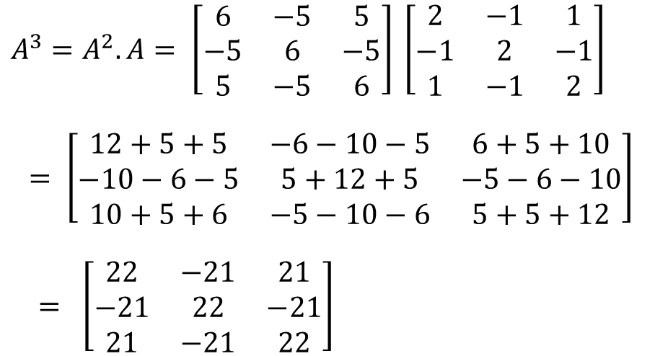
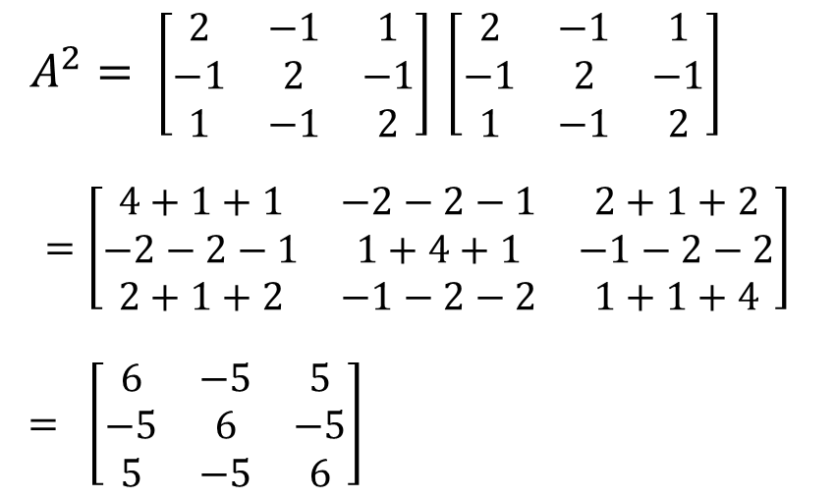
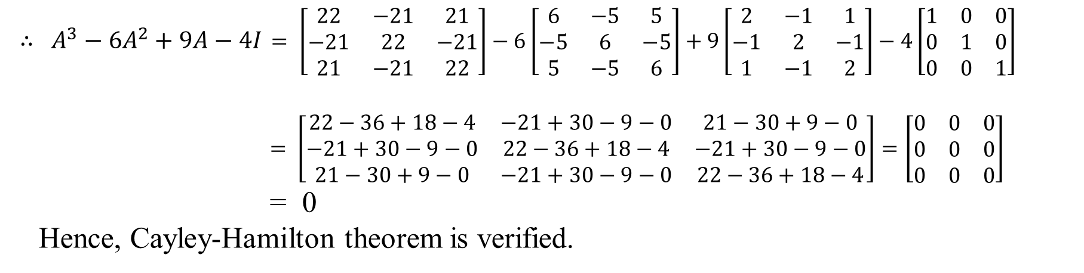
$A^{2}=$$\left[\begin{matrix}2 & −1 & 1 \\ −1 & 2 & −1 \\ 1 & −1 & 2\end{matrix}\right]$$\left[\begin{matrix}2 & −1 & 1 \\ −1 & 2 & −1 \\ 1 & −1 & 2\end{matrix}\right]$
$$=\left[\begin{matrix}4+1+1 & −2−2−1 & 2+1+2 \\ −2−2−1 & 1+4+1 & −1−2−2 \\ 2+1+2 & −1−2−2 & 1+1+4\end{matrix}\right]$$
$= \left[\begin{matrix}6 & −5 & 5 \\ −5 & 6 & −5 \\ 5 & −5 & 6\end{matrix}\right]$
$A^{3}=A^{2}.A= \left[\begin{matrix}6 & −5 & 5 \\ −5 & 6 & −5 \\ 5 & −5 & 6\end{matrix}\right]$$\left[\begin{matrix}2 & −1 & 1 \\ −1 & 2 & −1 \\ 1 & −1 & 2\end{matrix}\right]$
$= \left[\begin{matrix}12+5+5 & −6−10−5 & 6+5+10 \\ −10−6−5 & 5+12+5 & −5−6−10 \\ 10+5+6 & −5−10−6 & 5+5+12\end{matrix}\right]$
$= \left[\begin{matrix}22 & −21 & 21 \\ −21 & 22 & −21 \\ 21 & −21 & 22\end{matrix}\right]$
$∴ A^{3}−6A^{2}+9A−4I$$= \left[\begin{matrix}22 & −21 & 21 \\ −21 & 22 & −21 \\ 21 & −21 & 22\end{matrix}\right]−6\left[\begin{matrix}6 & −5 & 5 \\ −5 & 6 & −5 \\ 5 & −5 & 6\end{matrix}\right]+9\left[\begin{matrix}2 & −1 & 1 \\ −1 & 2 & −1 \\ 1 & −1 & 2\end{matrix}\right]−4\left[\begin{matrix}1 & 0 & 0 \\ 0 & 1 & 0 \\ 0 & 0 & 1\end{matrix}\right]$
$= \left[\begin{matrix}22−36+18−4 & −21+30−9−0 & 21−30+9−0 \\ −21+30−9−0 & 22−36+18−4 & −21+30−9−0 \\ 21−30+9−0 & −21+30−9−0 & 22−36+18−4\end{matrix}\right]=\left[\begin{matrix}0 & 0 & 0 \\ 0 & 0 & 0 \\ 0 & 0 & 0\end{matrix}\right]$
= 0
Hence, Cayley-Hamilton theorem is verified.

Slide 39
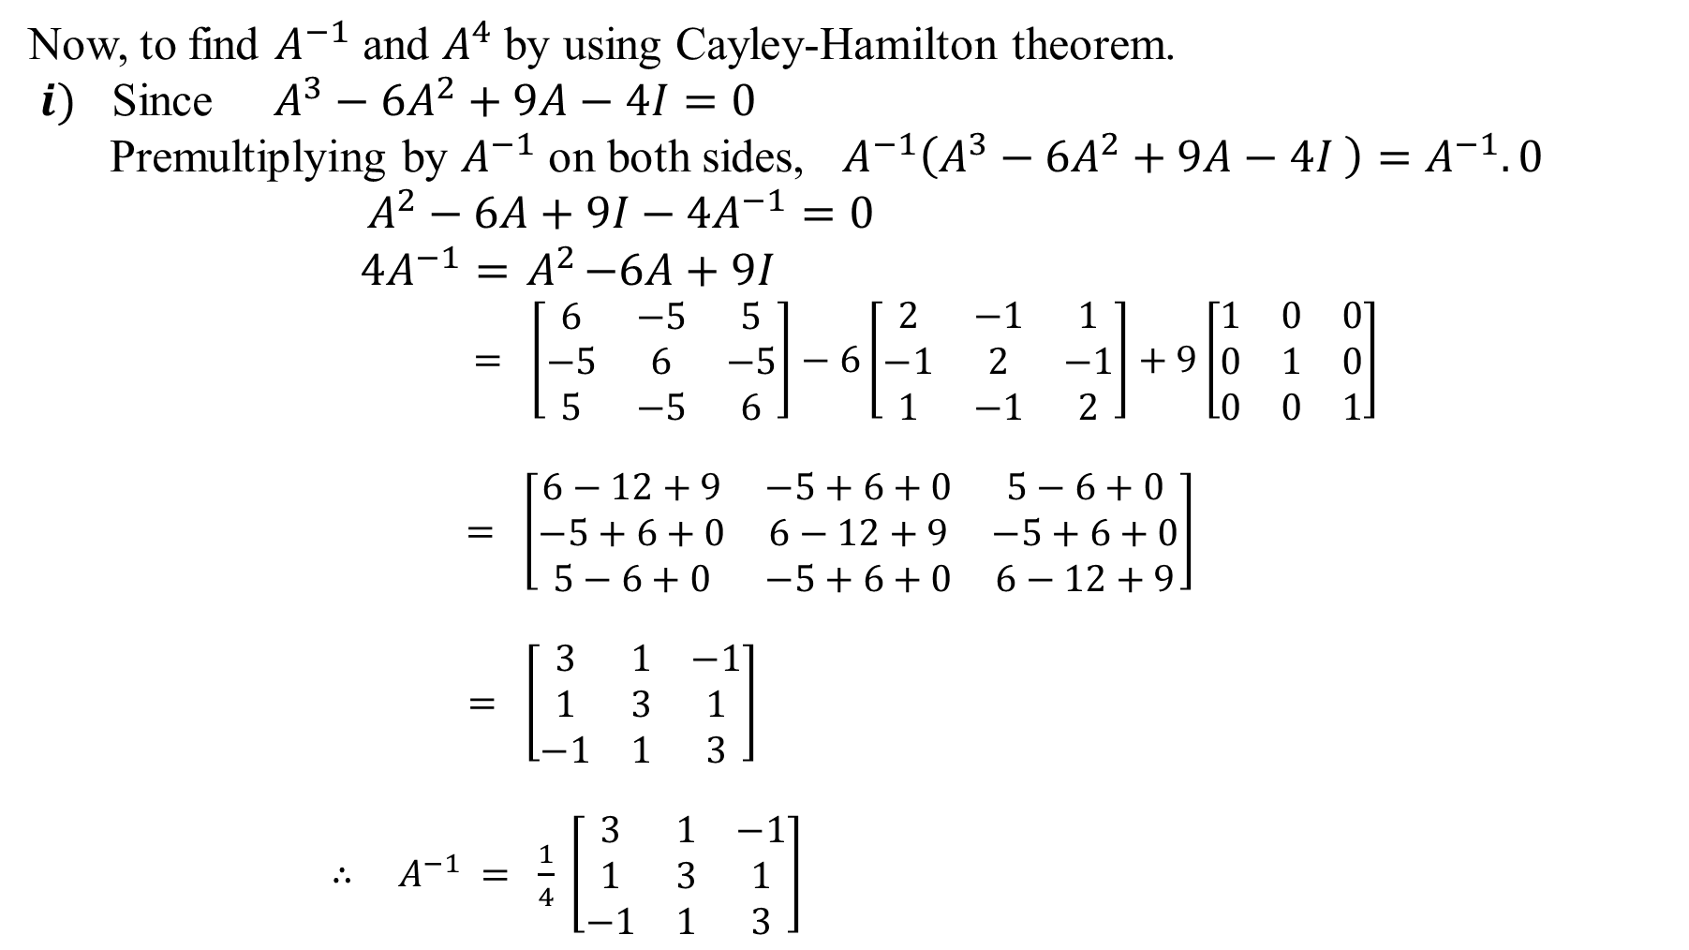
Now, to find $A^{−1}$ and $A^{4}$ by using Cayley-Hamilton theorem.
$i)$ Since $A^{3}−6A^{2}+9A−4I=0$
Premultiplying by $A^{−1}$ on both sides, $A^{−1}\left(A^{3}−6A^{2}+9A−4I \right)=A^{−1}.0$
$A^{2}−6A+9I−4A^{−1}=0$
$4A^{−1}={ A}^{2}−6A+9I$
$= \left[\begin{matrix}6 & −5 & 5 \\ −5 & 6 & −5 \\ 5 & −5 & 6\end{matrix}\right]−6\left[\begin{matrix}2 & −1 & 1 \\ −1 & 2 & −1 \\ 1 & −1 & 2\end{matrix}\right]+9\left[\begin{matrix}1 & 0 & 0 \\ 0 & 1 & 0 \\ 0 & 0 & 1\end{matrix}\right]$
$= \left[\begin{matrix}6−12+9 & −5+6+0 & 5−6+0 \\ −5+6+0 & 6−12+9 & −5+6+0 \\ 5−6+0 & −5+6+0 & 6−12+9\end{matrix}\right]$
$= \left[\begin{matrix}3 & 1 & −1 \\ 1 & 3 & 1 \\ −1 & 1 & 3\end{matrix}\right]$
$∴ A^{−1} = \frac{1}{4} \left[\begin{matrix}3 & 1 & −1 \\ 1 & 3 & 1 \\ −1 & 1 & 3\end{matrix}\right]$

Slide 40

$ii)$Since $A^{3}−6A^{2}+9A−4I=0$
Premultiplying by A on both sides, $A\left(A^{3}−6A^{2}+9A−4I \right)=A.0$
$A^{4}−6A^{3}+9A^{2}−4A=0$
$∴$$A^{4} = 6A^{3}−9A^{2}+4A$
$= 6\left[\begin{matrix}22 & −21 & 21 \\ −21 & 22 & −21 \\ 21 & −21 & 22\end{matrix}\right]−9\left[\begin{matrix}6 & −5 & 5 \\ −5 & 6 & −5 \\ 5 & −5 & 6\end{matrix}\right]+4\left[\begin{matrix}2 & −1 & 1 \\ −1 & 2 & −1 \\ 1 & −1 & 2\end{matrix}\right]$
$= \left[\begin{matrix}132−54+8 & −126+45−4 & 126−45+4 \\ −126+45−4 & 132−54+8 & −126+45−4 \\ 126−45+4 & −126+45−4 & 132−54+8\end{matrix}\right]$
$= \left[\begin{matrix}86 & −85 & 85 \\ −85 & 86 & −85 \\ 85 & −85 & 86\end{matrix}\right]$

Slide 41

Example 2: Find the eigenvalues of the matrix $A=\left[ \begin{matrix}1 & 4 \\ 2 & 3\end{matrix} \right]$ and verify the
Cayley-Hamilton theorem for this matrix. Find $A^{−1}$ and also, express
$A^{5}−4A^{4}−7A^{3}+11A^{2}−A−10I$ as a linear polynomial in A.
Sol: Given $A=\left[ \begin{matrix}1 & 4 \\ 2 & 3\end{matrix} \right]$
Its characteristic equation is $\left|A−λI\right|=0 ⇒ \left|\begin{matrix}1−λ & 4 \\ 2 & 3−λ\end{matrix}\right|=0$
$\left(or\right) λ^{2}−S_{1}λ+S_{2}=0$___(1)
Where $S_{1}=$trace of A = 1 + 3 = 4
$S_{2}= \left|A\right|=3−8=−5$
From (1), characteristic equation is $λ^{2}−4λ−5=0$
$\left(λ+1\right)\left(λ−5\right)=0$
$λ=−1, 5$
$∴$ Eigenvalues are $λ=−1, 5$

Slide 42

Now, to verify Cayley-Hamilton theorem for given matrix A.
i.e., to show that ${ A}^{2}−4A−5I=0$
$A^{2}=A.A=\left[ \begin{matrix}1 & 4 \\ 2 & 3\end{matrix} \right] \left[ \begin{matrix}1 & 4 \\ 2 & 3\end{matrix} \right]=\left[ \begin{matrix}1+8 & 4+12 \\ 2+6 & 8+9\end{matrix} \right]=\left[ \begin{matrix}9 & 16 \\ 8 & 17\end{matrix} \right]$
$∴ { A}^{2}−4A−5I$$= \left[ \begin{matrix}9 & 16 \\ 8 & 17\end{matrix} \right]−4\left[ \begin{matrix}1 & 4 \\ 2 & 3\end{matrix} \right]−5\left[ \begin{matrix}1 & 0 \\ 0 & 1\end{matrix} \right]$
$= \left[ \begin{matrix}9−4−5 & 16−16−0 \\ 8−8−0 & 17−12−5\end{matrix} \right]$
$= \left[ \begin{matrix}0 & 0 \\ 0 & 0\end{matrix} \right]$
$= 0$
$∴$ The matrix A satisfies its own characteristic equation.
i.e., The Cayley-Hamilton theorem is verified.

Slide 43

$i)$To find $A^{−1}$
Since ${ A}^{2}−4A−5I=0$
$A^{−1}\left({ A}^{2}−4A−5I \right)=A^{−1}.0$
$A−4I−5A^{−1}=0$
$5A^{−1 } = A−4I$
$= \left[ \begin{matrix}1 & 4 \\ 2 & 3\end{matrix} \right]−4\left[ \begin{matrix}1 & 0 \\ 0 & 1\end{matrix} \right]$
$= \left[ \begin{matrix}1−4 & 4−0 \\ 2−0 & 3−4\end{matrix} \right]$
$= \left[ \begin{matrix}−3 & 4 \\ 2 & −1\end{matrix} \right]$
$∴$$A^{−1 }$$= \frac{1}{5}\left[\begin{matrix}−3 & 4 \\ 2 & −1\end{matrix}\right]$

Slide 44

$ii) \text{To} \text{express} A^{5}−4A^{4}−7A^{3}+11A^{2}−A−10I \text{as} \text{a} \text{linear} \text{polynomial} \text{in} \text{A}\text{.}$
$A^{5}−4A^{4}−7A^{3}+11A^{2}−A−10I$
$= A^{5}−4A^{4}−5A^{3}−2A^{3}+11A^{2}−A−10I$
$= A^{3}\left(A^{2}−4A−5I\right)−$$2A^{3}+8A^{2}+3A^{2}+10A−11A−10I$
$= A^{3}\left(0\right)−2A\left(A^{2}−4A−5I\right)+3A^{2}−12A+A−15I+5I$
$= −2A\left(0\right)+3\left(A^{2}−4A−5I\right)+A+5I$
$= 3\left(0\right)+A+5I$
$= A+5I$, which is in a linear polynomial in A.

Slide 45

Example 3: Using Cayley-Hamilton theorem find $A^{8}$, if $A=\left[ \begin{matrix}1 & 2 \\ 2 & −1\end{matrix}\right]$
Sol:Given $A=\left[ \begin{matrix}1 & 2 \\ 2 & −1\end{matrix}\right]$
Its eigen equation is $\left|A−λI\right|=0 ⇒ \left|\begin{matrix}1−λ & 2 \\ 2 & −1−λ\end{matrix}\right|=0$
$\left(1−λ\right)\left(−1−λ\right)−4=0$
${−1−λ+λ+λ}^{2}−4=0$
$λ^{2}−5=0$
By Cayley-Hamilton theorem, A satisfies its characteristic equation.
Then $A^{2}−5I=0$
$⇒ A^{2}=5I$
$∴ A^{8} = {\left(A^{2}\right)}^{4}$
$= {\left(5I\right)}^{4}$
$= 625I$

Slide 46

Example 4: If $A=\left[ \begin{matrix}2 & 3 \\ 1 & 2\end{matrix} \right]$, express $A^{4}$ in powers of $A$.
Sol:Given $A=\left[ \begin{matrix}2 & 3 \\ 1 & 2\end{matrix} \right]$
Its eigen equation is $\left|A−λI\right|=0 ⇒ \left|\begin{matrix}2−λ & 3 \\ 1 & 2−λ\end{matrix}\right|=0$
$\left(2−λ\right)\left(2−λ\right)−3=0$
${4−2λ−2λ+λ}^{2}−3=0$
$λ^{2}−4λ+1=0$
By Cayley-Hamilton theorem, A satisfies its characteristic equation.
Then$A^{2}−4A+I=0$
$⇒ A^{2}=4A−I$
$∴ A^{4} = {\left(A^{2}\right)}^{2}$
$= {\left(4A−I \right)}^{2}$
$= 16A^{2}−8A+I$(or)
$= 16\left(4A−I\right)−8A+I$
$= 56A−15I$ , which is a linear polynomial in A.

Slide 47

Practice Problems:
Find the characteristic equation of $A=\left[\begin{matrix}1 & 2 & 3 \\ 2 & −1 & 4 \\ 3 & 1 & −1\end{matrix}\right]$ and hence verify C.H.T.
Verify Cayley-Hamilton theorem for the matrix $A=\left[\begin{matrix}1 & 2 & 3 \\ 2 & 4 & 5 \\ 3 & 5 & 6\end{matrix}\right]$, hence find $A^{−1}$.
( Ans: $A^{−1}=\left[\begin{matrix}1 & −3 & 2 \\ −3 & 3 & −1 \\ 2 & −1 & 0\end{matrix}\right]$ )
Using Cayley Hamilton theorem find the inverse of A and $A^{4}$of the matrix
$A=\left[\begin{matrix}7 & 2 & −2 \\ −6 & −1 & 2 \\ 6 & 2 & −1\end{matrix}\right]$. ( Ans: $A^{−1}=\frac{1}{3}\left[\begin{matrix}−3 & −2 & 2 \\ 6 & 5 & −2 \\ −6 & −2 & 5\end{matrix}\right], A^{4}=\left[\begin{matrix}241 & 80 & −80 \\ −240 & −79 & 80 \\ 240 & 80 & −79\end{matrix}\right]$ )
Show that the matrix $A=\left[\begin{matrix}0 & c & −b \\ −c & 0 & a \\ b & −a & 0\end{matrix}\right]$ satisfies it’s characteristic equation.
If $A=\left[\begin{matrix}1 & 2 \\ −1 & 3\end{matrix}\right],$ express $A^{6}−4A^{5}+8A^{4}−12A^{3}+14A^{2}$ as a linear polynomial
in $A.$( Ans: $−4A+5I$ )

Slide 48

Diagonalization of a matrix:
Similar Matrices:
If A and B are two square matrices of order n then B is said to be similar to A if there exists a nonsingular matrix P such that $B=P^{−1}AP$.
Note:
Similarity of matrices is an equivalence relation.
Similar matrices have the determinant.
Similar matrices have the same characteristic polynomial and, hence, the same
eigenvalues. If X is an eigenvector of A corresponding to the eigenvalue $λ$ then
$P^{−1}X$ is eigenvector of B corresponding to the eigenvalue $λ ,$ where$B=P^{−1}AP.$

Slide 49

Diagonalizable matrix:
A matrix A is said to be diagonalizableif it is similar to a diagonal matrix by
similar transformation.
(or)
If Ais a square matrix of order n and If there exists a non-singular matrix P of
order n such that $P^{−1}AP$ is a diagonal matrix D$(i.e.,P^{−1}AP=D)$ whose diagonal
elements are the eigenvalues of A, where $P=\left[\begin{matrix}X_{1} & X_{2} …… X_{n}\end{matrix}\right]$ whose columns
$\begin{matrix}X_{1}, & X_{2} …… X_{n}\end{matrix}$ are linearly independent eigenvectors corresponding to eigenvalues
of A, then the matrix A is called diagonalizable matrix.
Thisprocess is called diagonalization of a matrix.
Here the matrix D is called spectral matrix.
the matrix P is called modal matrix.

Slide 50
Imp. Notes:
A square matrix A of order n is diagonalizable if and only if it possesses n linearly
independent eigenvectors.
If the eigenvalues of the matrix A of order n are all distinct then it is always similar
to a diagonal matrix i.e., A is diagonalizable.
3) If the eigenvalues of the matrix A of order n are not distinct and if the algebraic
multiplicity(A.M) and geometric multiplicity(G.M) of each eigenvalue of A are
same, then the matrix A is diagonalizable i.e., similar to a diagonal matrix.
If A is similar to a diagonal matrix D, the diagonal elements of D are the eigenvalues of A.

Slide 51

Working Rule for Diagonalization of a Square Matrix A:
Step 1: Find the eigenvalues of the square matrix A.
Step 2: Find the eigenvectors corresponding to each eigenvalue.
Step 3: Check the condition A.M = G.M, for each eigenvalue of A.
Step 4: Find the modal matrix P having the eigenvectors as its column
vectors.
Step 5: Find the diagonal matrix $D=P^{−1}AP$. The diagonal matrix D has
eigenvalues as its diagonal elements.

Slide 52

Example 1: Show that the matrix A = $\left[\begin{matrix}8 & −6 & 2 \\ −6 & 7 & −4 \\ 2 & −4 & 3\end{matrix}\right]$ is similar to its diagonal matrix.
Find the diagonal and modal matrices.
Sol: Given A = $\left[\begin{matrix}8 & −6 & 2 \\ −6 & 7 & −4 \\ 2 & −4 & 3\end{matrix}\right]$
The characteristic equation is $\left|A−λI\right|=0$(or) $λ^{3}−S_{1}λ^{2}+S_{2}λ−S_{3}=0$__ (1)
where $S_{1}=$ trace of A = 8 + 7 +3 = 18
$S_{2}=$ sum of minors of principal diagonal elements of A
$= \left|\begin{matrix}7 & −4 \\ −4 & 3\end{matrix}\right|+\left|\begin{matrix}8 & 2 \\ 2 & 3\end{matrix}\right|+\left|\begin{matrix}8 & −6 \\ −6 & 7\end{matrix}\right| =$21 - 16 + 24 – 4 + 56 – 36 = 45
${ S}_{3} =$$\left|A\right|=8\left(21−16\right)+6\left(−18+8\right)+2\left(24−14\right)=$ 40 - 60 + 20 = 0
From (1), $λ^{3}−18λ^{2}+45λ−0=0$
$λ\left(λ^{2}−18λ+45\right)=0$ =>$λ\left(λ−3\right)\left(λ−15\right)=0$
$∴$ The characteristic roots of A are 0, 3, 15
And Algebraic multiplicity(A.M) of $λ=0$is 1
Algebraic multiplicity(A.M) of $λ=3$is 1
Algebraic multiplicity(A.M) of $λ=15$is 1

Slide 53


Let X be an eigen vector corresponding to eigen value $λ$of A, then the matrix equation is $\left(A−λI\right)X=0$
$R_{1}→\frac{1}{2}R_{1}, { R}_{2}→\frac{1}{20}R_{2}$
$\sim \left[\begin{matrix}4 & −3 & 1 \\ 0 & 1 & −1 \\ 0 & 0 & 0\end{matrix}\right]\left[\begin{matrix}x \\ y \\ z\end{matrix}\right]=\left[\begin{matrix}0 \\ 0 \\ 0\end{matrix}\right]$
Rank = r = 2 , n = 3 (no. of unknowns)
No. of arbitrary values (L.I vectors) = G.M = n – r = 3 – 2 = 1
$∴$ A.M = G.M for the eigenvalue $λ=0.$
Corresponding equations
4x – 3y + z = 0
y - z = 0
Let $z=k_{1} , k_{1}$ is non zero real number
Then y -$k_{1}$ = 0 => y = $k_{1}$
and 4x - 3$k_{1}+k_{1}$= 0 => x = $\frac{1}{2}$$k_{1}$
$∴$Eigen vector $X_{1}=\left[\begin{matrix}\frac{1}{2} k_{1} \\ k_{1} \\ k_{1}\end{matrix}\right]=\left[\begin{matrix} 1 \\ 2 \\ 2\end{matrix}\right]{\frac{1}{2}k}_{1}$corresponding to eigen value $λ=0.$
$i) If λ=0:$
AX = 0
$\left[\begin{matrix}8 & −6 & 2 \\ −6 & 7 & −4 \\ 2 & −4 & 3\end{matrix}\right]\left[\begin{matrix}x \\ y \\ z\end{matrix}\right]=\left[\begin{matrix}0 \\ 0 \\ 0\end{matrix}\right]$
$R_{2}→{8R}_{2}+{6R}_{1}, R_{3}→4R_{3}−R_{1}$
$\sim \left[\begin{matrix}8 & −6 & 2 \\ 0 & 20 & −20 \\ 0 & −10 & 10\end{matrix}\right]\left[\begin{matrix}x \\ y \\ z\end{matrix}\right]=\left[\begin{matrix}0 \\ 0 \\ 0\end{matrix}\right]$
$R_{3}→2R_{3}+R_{2}$
$\sim \left[\begin{matrix}8 & −6 & 2 \\ 0 & 20 & −20 \\ 0 & 0 & 0\end{matrix}\right]\left[\begin{matrix}x \\ y \\ z\end{matrix}\right]=\left[\begin{matrix}0 \\ 0 \\ 0\end{matrix}\right]$

Slide 54


$ii) If λ=3:$
$\left(A−λI\right)X=0 ⇒ \left(A−3I\right)X=0$
$\left[\begin{matrix}8−3 & −6 & 2 \\ −6 & 7−3 & −4 \\ 2 & −4 & 3−3\end{matrix}\right]$$\left[\begin{matrix}x \\ y \\ z\end{matrix}\right]=\left[\begin{matrix}0 \\ 0 \\ 0\end{matrix}\right]$
$\left[\begin{matrix}5 & −6 & 2 \\ −6 & 4 & −4 \\ 2 & −4 & 0\end{matrix}\right]\left[\begin{matrix}x \\ y \\ z\end{matrix}\right]=\left[\begin{matrix}0 \\ 0 \\ 0\end{matrix}\right]$
$R_{2}→{5R}_{2}+{6R}_{1}, R_{3}→5R_{3}−{2R}_{1}$
$\sim \left[\begin{matrix}5 & −6 & 2 \\ 0 & −16 & −8 \\ 0 & −8 & −4\end{matrix}\right]\left[\begin{matrix}x \\ y \\ z\end{matrix}\right]=\left[\begin{matrix}0 \\ 0 \\ 0\end{matrix}\right]$
$R_{3}→2R_{3}−R_{2}$
$\sim \left[\begin{matrix}5 & −6 & 2 \\ 0 & −16 & −8 \\ 0 & 0 & 0\end{matrix}\right]\left[\begin{matrix}x \\ y \\ z\end{matrix}\right]=\left[\begin{matrix}0 \\ 0 \\ 0\end{matrix}\right]$
${ R}_{2}→\frac{−1}{8}R_{2}$
$\sim \left[\begin{matrix}5 & −6 & 2 \\ 0 & 2 & 1 \\ 0 & 0 & 0\end{matrix}\right]\left[\begin{matrix}x \\ y \\ z\end{matrix}\right]=\left[\begin{matrix}0 \\ 0 \\ 0\end{matrix}\right]$
Rank = r = 2 , n = 3 (no. of unknowns)
No. of arbitrary values (L.I vectors) = G.M = n – r = 3 – 2 = 1
$∴$ A.M = G.M for eigenvalue $λ=3$.
Corresponding equations
5x – 6y + 2z = 0
2y + z = 0
Let $z=k_{2} , k_{2}$ is non zero real number
Then 2y +$k_{2}$ = 0 => y = $\frac{−1}{2}k_{2}$
and 5x - $6.\frac{−1}{2}k_{2}+2k_{2}$= 0 => x = -$k_{2}$
$∴$Eigen vector $X_{2}=\left[\begin{matrix}\text{−}k_{2} \\ \frac{−1}{2}k_{2} \\ k_{2}\end{matrix}\right]=\left[\begin{matrix}2 \\ 1 \\ −2\end{matrix}\right]$ ($\frac{−1}{2})k_{2}$corresponding to eigen value $λ=3.$

Slide 55


$iii) If λ=15:$
$\left(A−λI\right)X=0 ⇒ \left(A−15I\right)X=0$
$\left[\begin{matrix}8−15 & −6 & 2 \\ −6 & 7−15 & −4 \\ 2 & −4 & 3−15\end{matrix}\right]$$\left[\begin{matrix}x \\ y \\ z\end{matrix}\right]=\left[\begin{matrix}0 \\ 0 \\ 0\end{matrix}\right]$
$\left[\begin{matrix}−7 & −6 & 2 \\ −6 & −8 & −4 \\ 2 & −4 & −12\end{matrix}\right]\left[\begin{matrix}x \\ y \\ z\end{matrix}\right]=\left[\begin{matrix}0 \\ 0 \\ 0\end{matrix}\right]$
$R_{2}→{7R}_{2}−{6R}_{1}, R_{3}→7R_{3}+{2R}_{1}$
$\sim \left[\begin{matrix}−7 & −6 & 2 \\ 0 & −20 & −40 \\ 0 & −40 & −80\end{matrix}\right]\left[\begin{matrix}x \\ y \\ z\end{matrix}\right]=\left[\begin{matrix}0 \\ 0 \\ 0\end{matrix}\right]$
$R_{3}→R_{3}−{2R}_{2}$
$\sim \left[\begin{matrix}−7 & −6 & 2 \\ 0 & −20 & −40 \\ 0 & 0 & 0\end{matrix}\right]\left[\begin{matrix}x \\ y \\ z\end{matrix}\right]=\left[\begin{matrix}0 \\ 0 \\ 0\end{matrix}\right]$
${ R}_{2}→\frac{−1}{20}R_{2}$
$\sim \left[\begin{matrix}−7 & −6 & 2 \\ 0 & 1 & 2 \\ 0 & 0 & 0\end{matrix}\right]\left[\begin{matrix}x \\ y \\ z\end{matrix}\right]=\left[\begin{matrix}0 \\ 0 \\ 0\end{matrix}\right]$
Rank = r = 2 , n = 3 (no. of unknowns)
No. of arbitrary values (L.I vectors) = G.M = n – r = 3 – 2 = 1
$∴$ A.M = G.M for eigenvalue$λ=15$.
Corresponding equations
-7x – 6y + 2z = 0
y + 2z = 0
Let $z=k_{3} , k_{3}$ is non zero real number
Then y +${2k}_{3}$ = 0 => y = -2$k_{3}$
and -7x - $6(−2k_{3})+2k_{3}$= 0 => x = $2k_{3}$
$∴$Eigen vector $X_{3}=\left[\begin{matrix}2k_{3} \\ \text{−2}k_{3} \\ k_{3}\end{matrix}\right]=\left[\begin{matrix}2 \\ −2 \\ 1\end{matrix}\right]k_{3}$ corresponding to eigen value $λ=15.$

Slide 56

So that the linearly independent eigenvectors are$X_{1}=\left[\begin{matrix} 1 \\ 2 \\ 2\end{matrix}\right]$, $X_{2}=$$\left[\begin{matrix}2 \\ 1 \\ −2\end{matrix}\right]$ , $X_{3}= \left[\begin{matrix}2 \\ −2 \\ 1\end{matrix}\right]$
corresponding to eigenvalues $λ=0, 3, 15$ respectively.
$∴$ Modal matrix $P=\left[X_{1} X_{2} X_{3}\right] = \left[\begin{matrix}1 & 2 & 2 \\ 2 & 1 & −2 \\ 2 & −2 & 1\end{matrix}\right]$
and$\left|P\right|=1\left(1−4\right)−2\left(2+4\right)+2\left(−4−2\right)=−3−12−12=−27≠0$
Now, to find inverse matrix of the modal matrix P.
Cofactor matrix of $P= \left[\begin{matrix}−3 & −6 & −6 \\ −6 & −3 & 6 \\ −6 & 6 & −3\end{matrix}\right]$
Adjoint matrix of P = Transpose of cofactor matrix of P = $\left[\begin{matrix}−3 & −6 & −6 \\ −6 & −3 & 6 \\ −6 & 6 & −3\end{matrix}\right]$
i.e., Adj(P) = $−3\left[\begin{matrix}1 & 2 & 2 \\ 2 & 1 & −2 \\ 2 & −2 & 1\end{matrix}\right]$

Slide 57

$∴ P^{−1} = \frac{Adj(P)}{\left|P\right|} = \frac{−3\left[ \begin{matrix}1 & 2 & 2 \\ 2 & 1 & −2 \\ 2 & −2 & 1\end{matrix} \right]}{−27}$$= \frac{1}{9}\left[\begin{matrix}1 & 2 & 2 \\ 2 & 1 & −2 \\ 2 & −2 & 1\end{matrix}\right]$
Now, to find $P^{−1}AP=D$
$P^{−1}AP = \frac{1}{9}\left[\begin{matrix}1 & 2 & 2 \\ 2 & 1 & −2 \\ 2 & −2 & 1\end{matrix}\right]\left[\begin{matrix}8 & −6 & 2 \\ −6 & 7 & −4 \\ 2 & −4 & 3\end{matrix}\right]\left[\begin{matrix}1 & 2 & 2 \\ 2 & 1 & −2 \\ 2 & −2 & 1\end{matrix}\right]$
$= \frac{1}{9}\left[ \begin{matrix}8−12+4 & −6+14−8 & 2−8+6 \\ 16−6−4 & −12+7+8 & 4−4−6 \\ 16+12+2 & −12−14−4 & 4+8+3\end{matrix} \right]\left[\begin{matrix}1 & 2 & 2 \\ 2 & 1 & −2 \\ 2 & −2 & 1\end{matrix}\right]$
$= \frac{1}{9}\left[\begin{matrix}0 & 0 & 0 \\ 6 & 3 & −6 \\ 30 & −30 & 15\end{matrix}\right]\left[\begin{matrix}1 & 2 & 2 \\ 2 & 1 & −2 \\ 2 & −2 & 1\end{matrix}\right]$

Slide 58

$= \frac{1}{9}\left[ \begin{matrix}0+0+0 & 0+0+0 & 0+0+0 \\ 6+6−12 & 12+3+12 & 12−6−6 \\ 30−60+30 & 60−30−30 & 60+60+15\end{matrix} \right]$
$= \frac{1}{9}\left[\begin{matrix}0 & 0 & 0 \\ 0 & 27 & 0 \\ 0 & 0 & 135\end{matrix}\right]$
$= \left[\begin{matrix}0 & 0 & 0 \\ 0 & 3 & 0 \\ 0 & 0 & 15\end{matrix}\right]$
= D
$∴P^{−1}AP$= D$=\left[\begin{matrix}0 & 0 & 0 \\ 0 & 3 & 0 \\ 0 & 0 & 15\end{matrix}\right]$,which is a diagonal matrix (is also called spectral matrix).
The diagonal elements of D are the eigenvalues of the given matrix A.
Hence, the given matrix A is diagonalizable.

Slide 59

Example 2: Test for diagonalizable the matrix $\left[\begin{matrix}1 & 2 & 2 \\ 0 & 2 & 1 \\ −1 & 2 & 2\end{matrix}\right]$
Sol: Let A = $\left[\begin{matrix}1 & 2 & 2 \\ 0 & 2 & 1 \\ −1 & 2 & 2\end{matrix}\right]$
The characteristic equation is $\left|A−λI\right|=0$(or) $λ^{3}−S_{1}λ^{2}+S_{2}λ−S_{3}=0$__ (1)
where $S_{1}=$ trace of A $=1+2+2=5$
$S_{2}=$ sum of minors of principal diagonal elements of A
$= \left|\begin{matrix}2 & 1 \\ 2 & 2\end{matrix}\right|+\left|\begin{matrix}1 & 2 \\ −1 & 2\end{matrix}\right|+\left|\begin{matrix}1 & 2 \\ 0 & 2\end{matrix}\right| =4−2+2+2+2−0=8$
${ S}_{3} =$$\left|A\right|=1\left(4−2\right)−2\left(0+1\right)+2\left(0+2\right)=2−2+4=4$
From (1), $λ^{3}−5λ^{2}+8λ−4=0$
$(λ−1)\left(λ^{2}−4λ+4\right)=0$
$(λ−1)\left(λ−2\right)\left(λ−2\right)=0$
$∴$ The characteristic roots of A are 2, 2, 1
And Algebraic multiplicity(A.M) of $λ=2$is 2
Algebraic multiplicity(A.M) of $λ=1$is 1

Slide 60


Let X be an eigen vector corresponding to eigen value $λ$of A, then the matrix equation is $\left(A−λI\right)X=0$
$i) If λ=2:$
$\left(A−λI\right)X=0$
$⇒\left(A−2I\right)X=0$
$\left[\begin{matrix}1−2 & 2 & 2 \\ 0 & 2−2 & 1 \\ −1 & 2 & 2−2\end{matrix}\right]$$\left[\begin{matrix}x \\ y \\ z\end{matrix}\right]=\left[\begin{matrix}0 \\ 0 \\ 0\end{matrix}\right]$
$\left[\begin{matrix}−1 & 2 & 2 \\ 0 & 0 & 1 \\ −1 & 2 & 0\end{matrix}\right]\left[\begin{matrix}x \\ y \\ z\end{matrix}\right]=\left[\begin{matrix}0 \\ 0 \\ 0\end{matrix}\right]$
$R_{3}→R_{3}−R_{1}$
$\sim \left[\begin{matrix}−1 & 2 & 2 \\ 0 & 0 & 1 \\ 0 & 0 & −2\end{matrix}\right]\left[\begin{matrix}x \\ y \\ z\end{matrix}\right]=\left[\begin{matrix}0 \\ 0 \\ 0\end{matrix}\right]$
$R_{3}→R_{3}+2R_{2}$
$\sim \left[\begin{matrix}−1 & 2 & 2 \\ 0 & 0 & 1 \\ 0 & 0 & 0\end{matrix}\right]\left[\begin{matrix}x \\ y \\ z\end{matrix}\right]=\left[\begin{matrix}0 \\ 0 \\ 0\end{matrix}\right]$
Rank = r = 2 , No. of unknowns = n = 3
No. of arbitrary values ( L.I vectors ) = G.M = n – r
= 3 – 2
= 1
But A.M of $λ=2$is 2
Then A.M $≠$ G.M for eigenvalue $λ=2$.
Hence, given matrix A is not diagonalizable.

Slide 61

Calculation of Powers of a Matrix:
We can find the powers of a square matrix by using diagonalization.
Let A be a square matrix of order n, then there exists an invertible matrix P such that
$D=P^{−1}AP$
Now, $D^{2}=D.D=$$\left(P^{−1}AP\right)\left(P^{−1}AP\right)$
$= P^{−1}A\left(PP^{−1}\right)AP$
$=$$P^{−1}A\left(I\right)AP$
$∴ D^{2}= P^{−1}A^{2}P$
Similarly, we get $D^{3}= P^{−1}A^{3}P$, $D^{4}= P^{−1}A^{4}P$………, $D^{n}= P^{−1}A^{n}P$
Now, pre-multiplying $D^{n}$ by P and post-multiplying by $P^{−1}$, we get
$PD^{n}P^{−1} = PP^{−1}A^{n}PP^{−1}$
$= IA^{n}I$
$=$${ A}^{n}$
$∴ A^{n}=$$PD^{n}P^{−1} , n∈N$

Slide 62

Example: Find the modal matrix P which transform the matrix $A=\left[\begin{matrix}1 & 0 & −1 \\ 1 & 2 & 1 \\ 2 & 2 & 3\end{matrix}\right]$ to
diagonal form. Hence calculate $A^{4}$.
Sol:Given $A=\left[\begin{matrix}1 & 0 & −1 \\ 1 & 2 & 1 \\ 2 & 2 & 3\end{matrix}\right]$
The characteristic equation is $\left|A−λI\right|=0$(or) $λ^{3}−S_{1}λ^{2}+S_{2}λ−S_{3}=0$
Eigenvalues of A are $λ=1, 2, 3$
Let X be an eigen vector corresponding to eigen value $λ$of A, then the matrix equation is $\left(A−λI\right)X=0$
$i) If λ=1:$$\left(A−λI\right)X=0$$⇒ \left(A−I\right)X=0$
$∴$L.I eigenvector $X_{1}=\left[\begin{matrix}1 \\ −1 \\ 0\end{matrix}\right]$ corresponding to eigenvalue $λ=1$.

Slide 63

$ii) If λ=2:$$\left(A−λI\right)X=0$$⇒ \left(A−2I\right)X=0$
$∴$L.I eigenvector $X_{2}=\left[\begin{matrix}−2 \\ 1 \\ 2\end{matrix}\right]$ corresponding to eigenvalue $λ=2$.
$iii) If λ=3:$$\left(A−λI\right)X=0$$⇒ \left(A−3I\right)X=0$
$∴$L.I eigenvector $X_{3}=\left[\begin{matrix}−1 \\ 1 \\ 2\end{matrix}\right]$ corresponding to eigenvalue $λ=3$.
$∴$ Modal matrix $P=\left[X_{1} X_{2} X_{3}\right] = \left[\begin{matrix}\begin{matrix}1 \\ −1 \\ 0\end{matrix} & \begin{matrix}−2 \\ 1 \\ 2\end{matrix} & \begin{matrix}−1 \\ 1 \\ 2\end{matrix}\end{matrix}\right]$
Now, to find inverse matrix of the modal matrix P. i.e., $P^{−1} = \frac{Adj(P)}{\left|P\right|}$
$∴ P^{−1}=\frac{−1}{2}\left[\begin{matrix}0 & 2 & −1 \\ 2 & 2 & 0 \\ −2 & −2 & −1\end{matrix}\right]$

Slide 64

Now, to find ${D= P}^{−1}AP$
${D = P}^{−1}AP = \frac{ −1}{2}\left[\begin{matrix}0 & 2 & −1 \\ 2 & 2 & 0 \\ −2 & −2 & −1\end{matrix}\right]\left[\begin{matrix}1 & 0 & −1 \\ 1 & 2 & 1 \\ 2 & 2 & 3\end{matrix}\right]\left[\begin{matrix}\begin{matrix}1 \\ −1 \\ 0\end{matrix} & \begin{matrix}−2 \\ 1 \\ 2\end{matrix} & \begin{matrix}−1 \\ 1 \\ 2\end{matrix}\end{matrix}\right]$
$= \left[\begin{matrix}1 & 0 & 0 \\ 0 & 2 & 0 \\ 0 & 0 & 3\end{matrix}\right]$, which is diagonal matrix ( Spectral matrix )
The diagonal elements of D are the eigenvalues of the given matrix A.
Hence, the given matrix A is diagonalizable.
Now, to find $A^{4}$
Since $A^{n}=$$PD^{n}P^{−1} , n∈N$
=>$A^{4}=$$PD^{4}P^{−1}$

Slide 65

$∴ A^{4} = \left[\begin{matrix}\begin{matrix}1 \\ −1 \\ 0\end{matrix} & \begin{matrix}−2 \\ 1 \\ 2\end{matrix} & \begin{matrix}−1 \\ 1 \\ 2\end{matrix}\end{matrix}\right]{\left[\begin{matrix}1 & 0 & 0 \\ 0 & 2 & 0 \\ 0 & 0 & 3\end{matrix}\right]}^{4}(\frac{ −1}{2})\left[\begin{matrix}0 & 2 & −1 \\ 2 & 2 & 0 \\ −2 & −2 & −1\end{matrix}\right]$
$= \left[\begin{matrix}\begin{matrix}1 \\ −1 \\ 0\end{matrix} & \begin{matrix}−2 \\ 1 \\ 2\end{matrix} & \begin{matrix}−1 \\ 1 \\ 2\end{matrix}\end{matrix}\right]\left[\begin{matrix}1^{4} & 0 & 0 \\ 0 & 2^{4} & 0 \\ 0 & 0 & 3^{4}\end{matrix}\right]\left(\frac{ −1}{2}\right)\left[\begin{matrix}0 & 2 & −1 \\ 2 & 2 & 0 \\ −2 & −2 & −1\end{matrix}\right]$
$= \left[\begin{matrix}\begin{matrix}1 \\ −1 \\ 0\end{matrix} & \begin{matrix}−2 \\ 1 \\ 2\end{matrix} & \begin{matrix}−1 \\ 1 \\ 2\end{matrix}\end{matrix}\right]\left[\begin{matrix}1 & 0 & 0 \\ 0 & 16 & 0 \\ 0 & 0 & 81\end{matrix}\right](\frac{ −1}{2})\left[\begin{matrix}0 & 2 & −1 \\ 2 & 2 & 0 \\ −2 & −2 & −1\end{matrix}\right]$
$= \left[\begin{matrix}−49 & −50 & −40 \\ 65 & 66 & 40 \\ 130 & 130 & 81\end{matrix}\right]$

Slide 66

Practice Problems:
Diagonalize the matrix $A=\left[\begin{matrix}−2 & 2 & −3 \\ 2 & 1 & −6 \\ −1 & −2 & 0\end{matrix}\right]$
Test for diagonalization for the matrix $A=\left[\begin{matrix}2 & −2 & −2 \\ −2 & 3 & −1 \\ 2 & −1 & 3\end{matrix}\right]$
3. Find modal matrix P which transform the matrix $A=\left[\begin{matrix}8 & −8 & −2 \\ 4 & −3 & −2 \\ 3 & −4 & 1\end{matrix}\right]$ to diagonal
form. Hence calculate $A^{4}$.

Slide 67

Orthogonally Similar Matrices:
IfA and B are two square matrices of order n then B is said to be
orthogonally similar to A if there exists an orthogonal matrix P such that $B=P^{−1}AP$.
Since P is orthogonal, $P^{−1}=P^{T}$, then we write $B=P^{−1}AP=$$P^{T}AP$.
Note:
1) To find the orthogonal matrix P , each element of the eigenvector is divided by its
norm (length).
A real symmetric matrix of order n has mutually orthogonal real eigenvectors.
Any two eigenvectors corresponding to two distinct eigenvalues of a real symmetric
matrix are orthogonal.

Slide 68

Example: Determine a diagonal matrix orthogonally similar (orthogonal
reduction) to the real symmetric matrix $\left[\begin{matrix}6 & −2 & 2 \\ −2 & 3 & −1 \\ 2 & −1 & 3\end{matrix}\right].$Also, find the
modal matrix.
Sol:Let $A=\left[\begin{matrix}6 & −2 & 2 \\ −2 & 3 & −1 \\ 2 & −1 & 3\end{matrix}\right]$
The characteristic equation is $\left|A−λI\right|=0$(or) $λ^{3}−S_{1}λ^{2}+S_{2}λ−S_{3}=0$
Eigenvalues of A are $λ=8, 2, 2$
Let X be an eigen vector corresponding to eigen value $λ$of A, then the matrix
equation is $\left(A−λI\right)X=0$
$i) λ=8:$
Matrix equation is $\left(A−λI\right)X=0 ⇒$$\left(A−8I\right)X=0$
$∴$L.I eigenvector $X_{1}=\left[\begin{matrix}2 \\ −1 \\ 1\end{matrix}\right]$ corresponding to eigenvalue $λ=8$.

Slide 69

$ii) If λ=2:$
$\left(A−λI\right)X=0$$⇒ \left(A−2I\right)X=0$
$∴$L.I eigenvectors $X_{2}=\left[\begin{matrix}1 \\ 2 \\ 0\end{matrix}\right]$ , $X_{3}=\left[\begin{matrix}−1 \\ 0 \\ 2\end{matrix}\right]$ corresponding to eigenvalue $λ=2$.
Hence,The linearly independent eigenvectors are $X_{1}=\left[\begin{matrix}2 \\ −1 \\ 1\end{matrix}\right]$ , $X_{2}=$$\left[\begin{matrix}1 \\ 2 \\ 0\end{matrix}\right]$, $X_{3}=$$\left[\begin{matrix}−1 \\ 0 \\ 2\end{matrix}\right]$
Since, The orthogonal modal matrix has mutually orthogonal eigenvectors.
Now verifying these three eigenvectors are orthogonal or not.
$∴ X_{1}^{T}X_{2}=\left[\begin{matrix}2 & −1 & 1\end{matrix}\right]\left[\begin{matrix}1 \\ 2 \\ 0\end{matrix}\right]=2−2+0=0,$
${ X}_{1}^{T}X_{3}=\left[\begin{matrix}2 & −1 & 1\end{matrix}\right]\left[\begin{matrix}−1 \\ 0 \\ 2\end{matrix}\right]=−2−0+2=0$
And ${ X}_{2}^{T}X_{3}$$=\left[\begin{matrix}1 & 2 & 0\end{matrix}\right]\left[\begin{matrix}−1 \\ 0 \\ 2\end{matrix}\right]=−1+0+0=−1≠0$

Slide 70

We observing, $X_{1}, X_{2}$and $X_{1}, X_{3}$ are orthogonal, but $X_{2}, X_{3}$ are not orthogonal.
Now choose the eigenvector $X_{3}=\left[\begin{matrix}a \\ b \\ c\end{matrix}\right]$ such that ${ X}_{1}^{T}X_{3}=0$ and ${ X}_{2}^{T}X_{3}=0$
$∴ X_{1}^{T}X_{3}=\left[\begin{matrix}2 & −1 & 1\end{matrix}\right]\left[\begin{matrix}a \\ b \\ c\end{matrix}\right]=0 ⇒ 2a−b+c=0$____(1)
and ${ X}_{2}^{T}X_{3}$$=\left[\begin{matrix}1 & 2 & 0\end{matrix}\right]\left[\begin{matrix}a \\ b \\ c\end{matrix}\right]=0 ⇒ a+2b=0$_____(2)
Solving (1) & (2), $\frac{a}{\left|\begin{matrix}−1 & 1 \\ 2 & 0\end{matrix}\right|}=\frac{−b}{\left|\begin{matrix}2 & 1 \\ 1 & 0\end{matrix}\right|}=\frac{c}{\left|\begin{matrix}2 & −1 \\ 1 & 2\end{matrix}\right|}=t (≠0, say)$
$\frac{a}{−2}=\frac{−b}{−1}=\frac{c}{5}=t \left(or\right) \frac{a}{−2}=\frac{b}{1}=\frac{c}{5}=t$
$⇒ a=−2t, b=t, c=5t$

Slide 71

Therefore, eigenvector $X_{3}=\left[\begin{matrix}−2t \\ t \\ 5t\end{matrix}\right]= \left[\begin{matrix}−2 \\ 1 \\ 5\end{matrix}\right]t$ , corresponding to eigenvalue $λ=2$.
Hence, the linearly independent mutually orthogonal eigenvectors of A are
$X_{1}=\left[\begin{matrix}2 \\ −1 \\ 1\end{matrix}\right]$ , $X_{2}=$$\left[\begin{matrix}1 \\ 2 \\ 0\end{matrix}\right]$, $X_{3}=$$\left[\begin{matrix}−2 \\ 1 \\ 5\end{matrix}\right]$
Length of eigenvector $X_{1}=\left\|X_{1}\right\|=\sqrt{2^{2}+{\left(−1\right)}^{2}+1^{2}}=\sqrt{6}$
Length of eigenvector $X_{2}=\left\|X_{2}\right\|=\sqrt{1^{2}+2^{2}+0}=\sqrt{5}$
Length of eigenvector $X_{3}=\left\|X_{3}\right\|=\sqrt{{(−2)}^{2}+1^{2}+5^{2}}=\sqrt{30}$
The normalized eigenvectors are $X_{1}=\left[\begin{matrix}\frac{2}{\sqrt{6}} \\ \frac{−1}{\sqrt{6}} \\ \frac{1}{\sqrt{6}}\end{matrix}\right]$ , $X_{2}=\left[\begin{matrix}\frac{1}{\sqrt{5}} \\ \frac{2}{\sqrt{5}} \\ 0\end{matrix}\right]$ , $X_{3}=\left[\begin{matrix}\frac{−2}{\sqrt{30}} \\ \frac{1}{\sqrt{30}} \\ \frac{5}{\sqrt{30}}\end{matrix}\right]$

Slide 72

$∴$ The modal matrix P has normalized eigenvectors as its column vectors.
i.e., $P= \left[\begin{matrix}X_{1} & X_{2} & X_{3}\end{matrix}\right]$$= \left[\begin{matrix}\frac{2}{\sqrt{6}} & \frac{1}{\sqrt{5}} & \frac{−2}{\sqrt{30}} \\ \frac{−1}{\sqrt{6}} & \frac{2}{\sqrt{5}} & \frac{1}{\sqrt{30}} \\ \frac{1}{\sqrt{6}} & 0 & \frac{5}{\sqrt{30}}\end{matrix}\right]$
Since P is orthogonal matrix =>$P^{−1}=P^{T}=\left[\begin{matrix}\frac{2}{\sqrt{6}} & \frac{−1}{\sqrt{6}} & \frac{1}{\sqrt{6}} \\ \frac{1}{\sqrt{5}} & \frac{2}{\sqrt{5}} & 0 \\ \frac{−2}{\sqrt{30}} & \frac{1}{\sqrt{30}} & \frac{5}{\sqrt{30}}\end{matrix}\right]$
Now, $D= P^{T}AP = \left[\begin{matrix}\frac{2}{\sqrt{6}} & \frac{−1}{\sqrt{6}} & \frac{1}{\sqrt{6}} \\ \frac{1}{\sqrt{5}} & \frac{2}{\sqrt{5}} & 0 \\ \frac{−2}{\sqrt{30}} & \frac{1}{\sqrt{30}} & \frac{5}{\sqrt{30}}\end{matrix}\right]\left[\begin{matrix}6 & −2 & 2 \\ −2 & 3 & −1 \\ 2 & −1 & 3\end{matrix}\right]\left[\begin{matrix}\frac{2}{\sqrt{6}} & \frac{1}{\sqrt{5}} & \frac{−2}{\sqrt{30}} \\ \frac{−1}{\sqrt{6}} & \frac{2}{\sqrt{5}} & \frac{1}{\sqrt{30}} \\ \frac{1}{\sqrt{6}} & 0 & \frac{5}{\sqrt{30}}\end{matrix}\right]$
$= \left[\begin{matrix}8 & 0 & 0 \\ 0 & 2 & 0 \\ 0 & 0 & 2\end{matrix}\right]$ ,which is diagonal matrix ( spectral matrix )

Slide 73

Practice Problems:
Use orthogonal reduction the following symmetric matrices reduced to diagonal form.
1) $\left[\begin{matrix}1 & 0 & 0 \\ 0 & 1 & 1 \\ 0 & 1 & 1\end{matrix}\right]$
2) $\left[\begin{matrix}3 & 1 & 1 \\ 1 & 3 & −1 \\ 1 & −1 & 3\end{matrix}\right]$

Slide 74
Thank You

